Slide 1
Lecture 10: Adding buildup

Slide 2
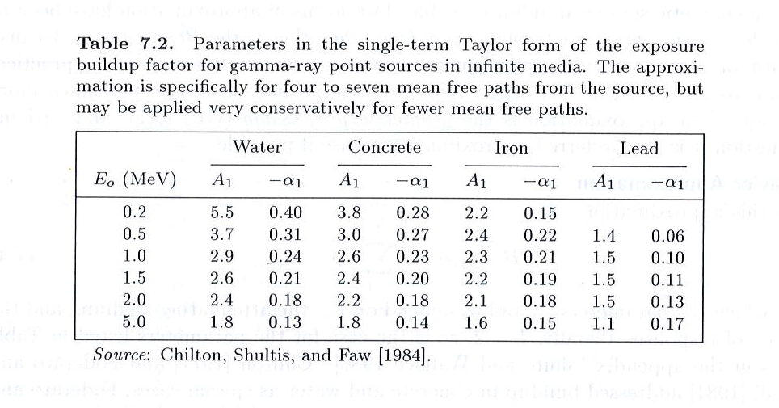

Slide 3
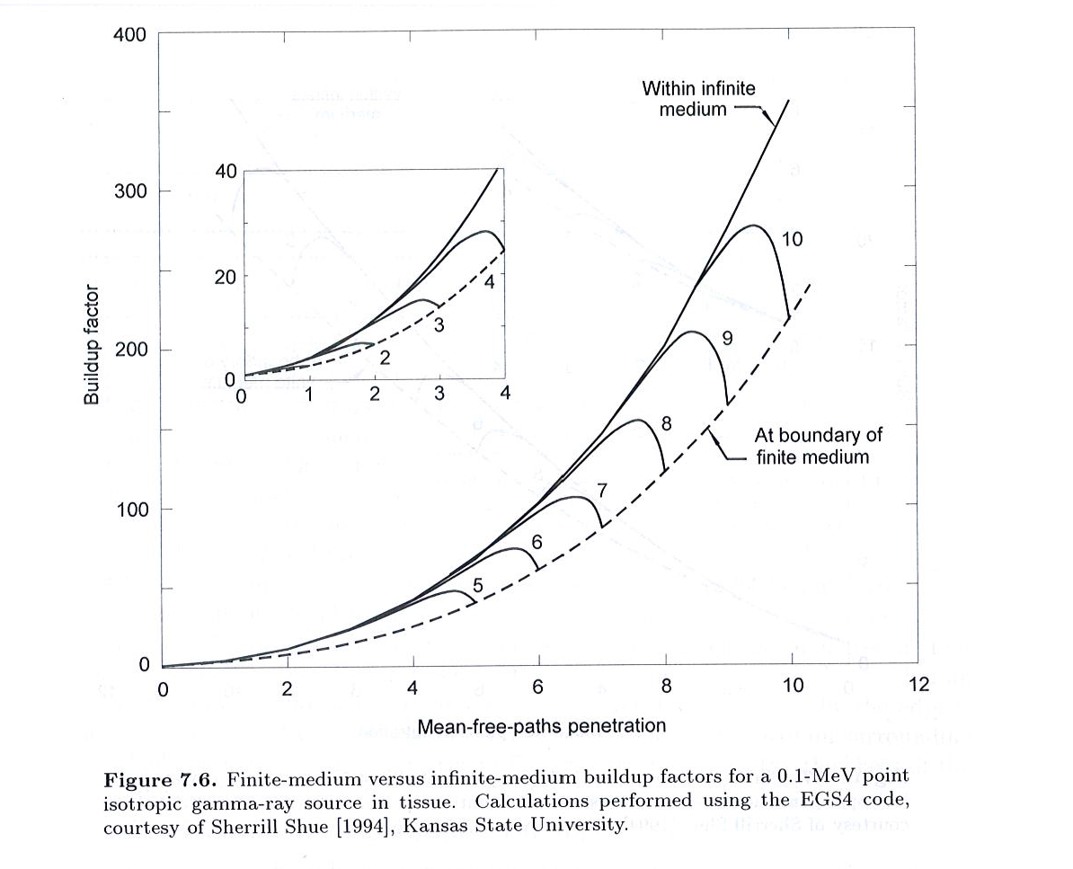

Slide 4
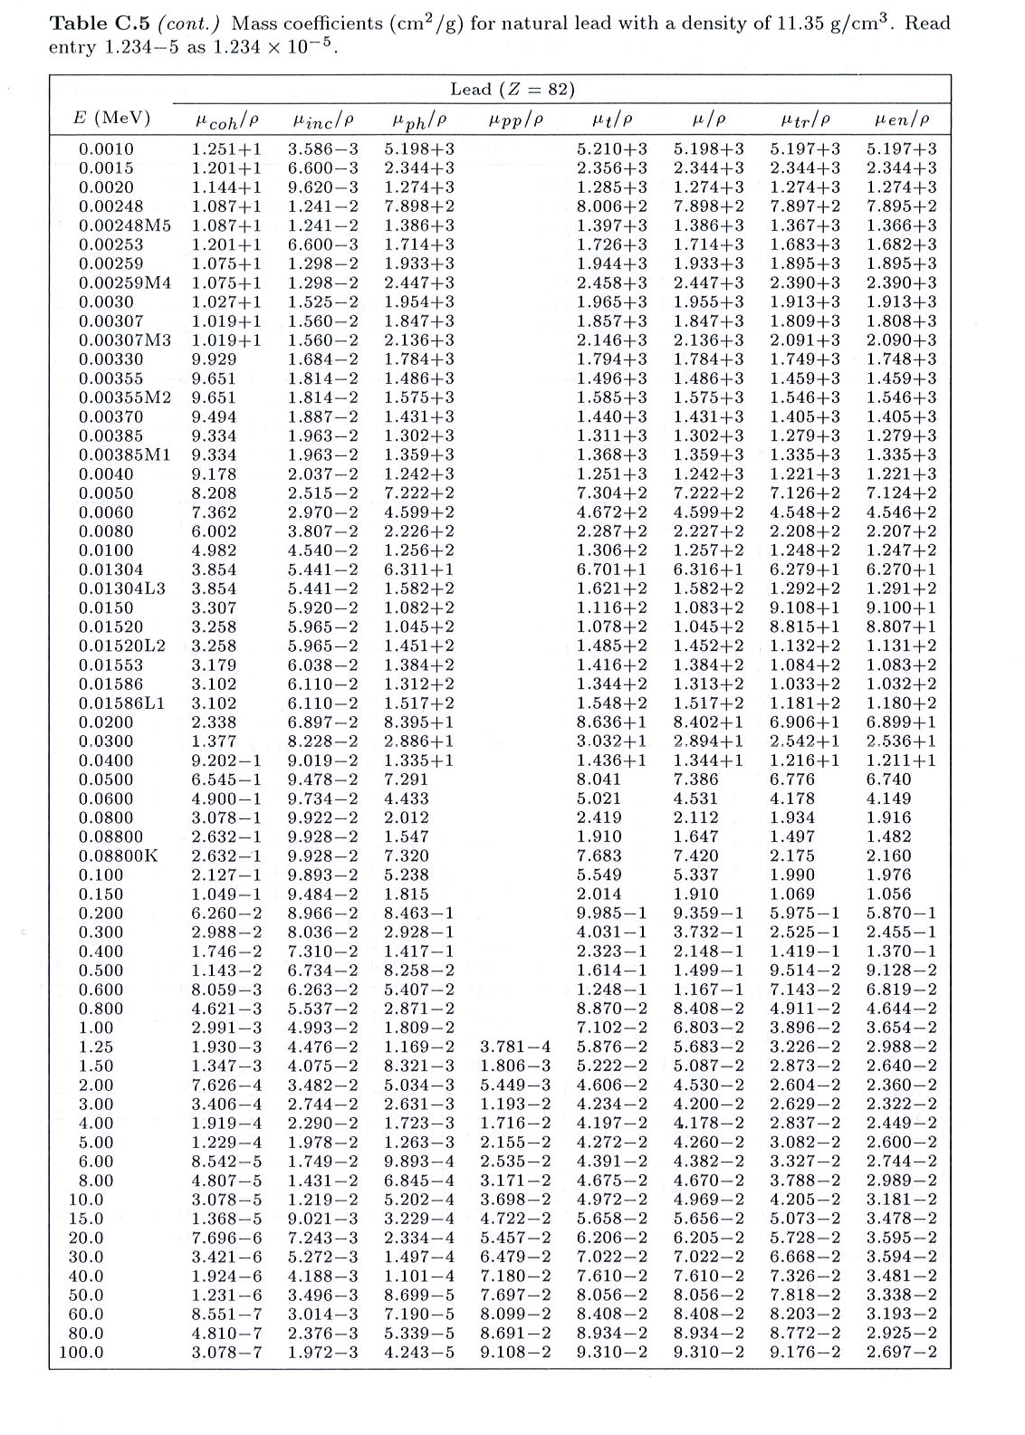

Slide 5
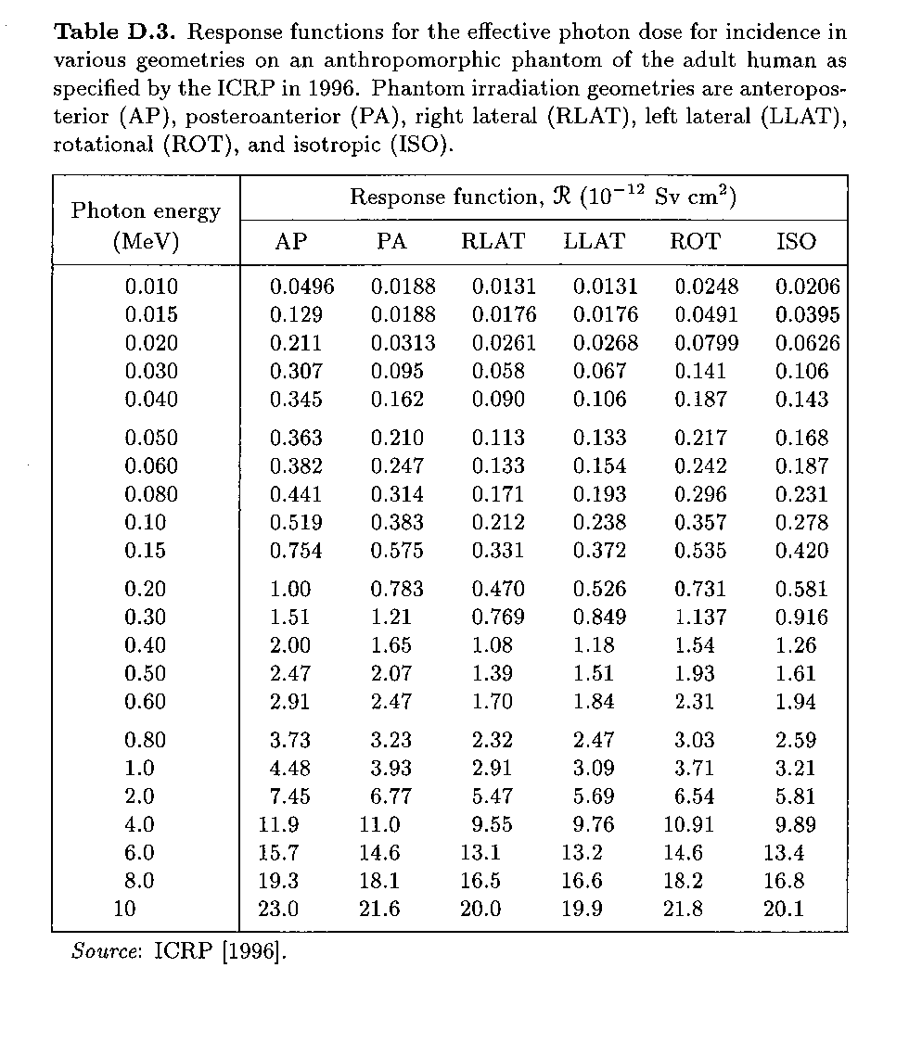

Slide 6
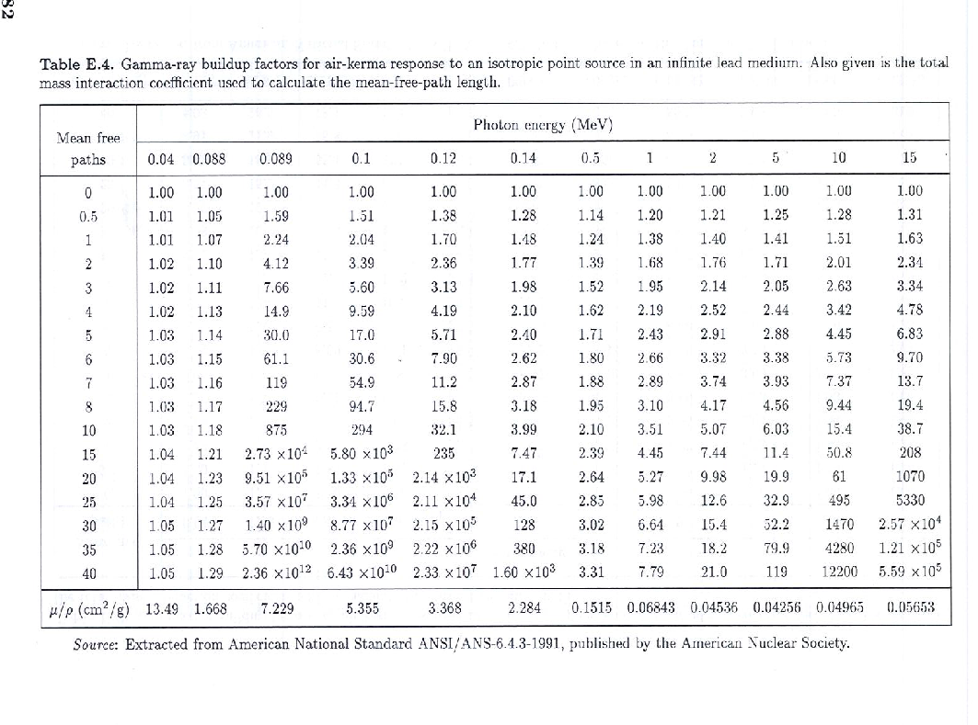

Slide 7
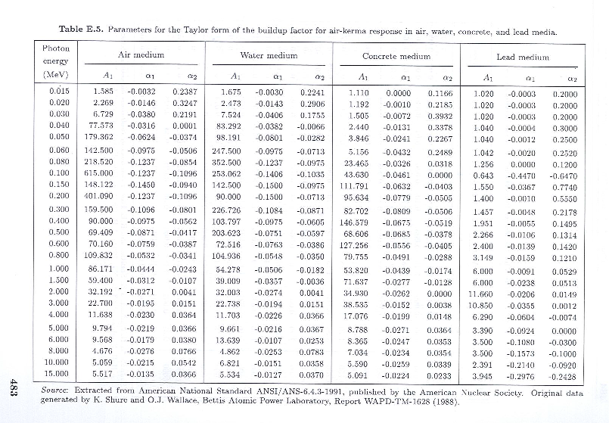

Slide 8
  HW 6.1
See HW6p1.pdf in the Public area of the class website.

