Slide 1
Lecture 2:Basic Concepts
Use the course notes on:
  Direction and solid angles
  Fundamental radiation field variables
  Directional properties of radiation
MCNP reinforcement of concepts
  Shultis and Faw tutorial
  Additional macro surfaces
  Introduction to VisEd
  Determining solid angles
  Representing particle beams and reflection

Slide 2
  Shultis and Faw tutorial
In the course Public area
Same authors as our textbook

Slide 3
  Additional macro surfaces
We will build on the SPH (sphere) that we learned last week by adding
  RPP (rectangular parallelpiped = box)
  RCC (right circular cylinder)
  TRC (truncated cone)
  TX, TY, and TZ (torus)

Slide 4
Macro Boxes: RPP
Syntax:
Description: Rectangular parallelpided surface with dimensions:
Xmin,Xmax →Xrange
Ymin,Ymax →Yrange
Zmin,Zmax →Zrange
Surface numbers:
  .1 +x
  .2 –x
  .3 +y
  .4 –y
  .5 +z
  .6 –z

Slide 5
Macro Spheres: SPH
Syntax:
Description: General sphere, centered on with radius R
Surface numbers (none needed. Just one surface.)

Slide 6
Macro Cylinders: RCC
Syntax:
Description: Right circular cylinder surface with dimensions
Vx, Vy, Vz → Coordinates of center of base
Hx,Hy,Hz → Vector of axis
R → radius
Surface numbers:
  .1 +r (curved boundary)
  .2 End of H (usually the top)
  .3 Beginning of H (usually the bottom)

Slide 7
Macro Cones: TRC
Syntax:
Description: Truncated right cone
Vx, Vy, Vz → Coordinates of center of base
Hx,Hy,Hz → Vector of axis
R1 → radius of base
R2 → radius of top
Surface numbers:
  .1 +r (curved boundary)
  .2 End of H (usually the top)
  .3 Beginning of H (usually the bottom)
MCNP5 Manual Page: 3-19

Slide 8
Torus: TX or TY or TZ
Syntax:
The TZ is for a donut lying on a table. If you are setting it on edge (i.e., like a wheel ready to roll), the axis (i.e., axle of the wheel) must be the x-axis (TX) or y-axis (TY)
Description: Truncated right cone
C_{x},C_{y},C_{z} → Coordinates of absolute center (in the center
of the hole at ½ of the thickness of donut)
R_{major} → Radius of the circle that goes from the center to
the mid-circle of the
“tube” of the donut (It would be the radius if
the whole torus were reduced to a simple
circle=infinitely “thin” donut)
r_{minor} → Radius of the “tube” of the donut

Slide 9
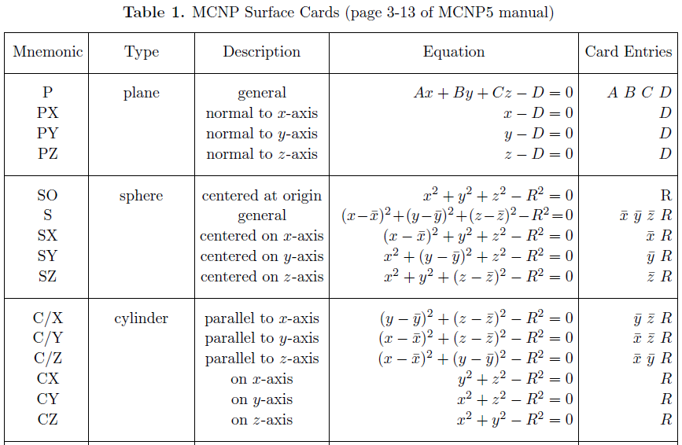
Other

Slide 10
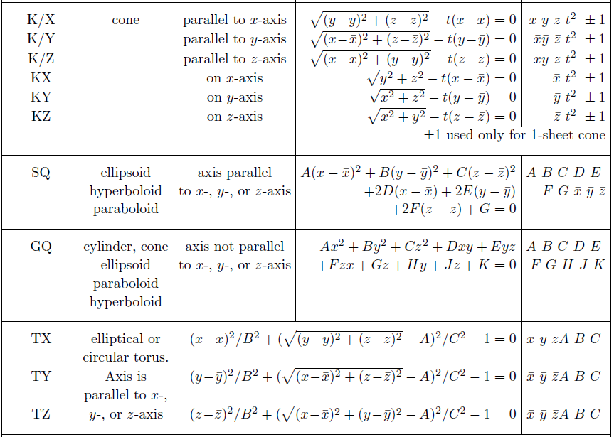
Other (2)

Slide 11
VisEd Cheat Sheet
Start VisEd.
File->Open (Do not modify input) to choose and open the input file
Click “Color” in both windows
Zoom in OR Zoom out to get them right
As desired:
  Click “Cell” or “Surf” to see cell numbers
  Click “Origin” to make the window “sensitive” to subsequent clicks (in either window)
  Insert origin coordinates to move around

Slide 12
  VisEd example
Inside a box (100x100x100)
Torus of Rmajor=20, Rminor=5 on floor
Cylinder of radius 20, ht 40 on top of torus
Sphere of radius 10 centered in cylinder

Slide 13
  Determining solid angles
The determination of solid angles using MCNP is very straightforward, once you get oriented:
  The “eye point” is replaced with an isotropic point source (energy or particle type doesn’t matter)
  The surface(s) that you want the solid angle calculated for is modeled as part of a 3D cell (and checked with VisEd, if desired).
  The entire geometry is filled with void (mat#=0)
  The tally is a surface crossing tally (F1:n or F1:p)
To figure out the answer, you need to notice whether the particles will cross the surface once (e.g., top of cylinder or one face of RPP) or twice (e.g., sphere)

Slide 14
  Solid Angle Examples
Disk of radius 1 from 10 above
Sphere of radius 2 from 20 above center
Torus (Rmajor=10, Rminor=2) from 20 cm above its center

Slide 15
  HW 1.1
Use a hand calculation to compute the solid angle subtended by a sphere of radius 5 cm whose center is 25 cm from the point of view
Check your calculation with an MCNP calculation (within 0.1% error)

Slide 16
  HW 1.2
Use a hand calculation to compute the solid angle subtended by a torus (lying flat on the floor) with major radius 10 cm and minor radius of 1 cm, as viewed from the point 20 cm above the floor.
Check your calculation with an MCNP calculation (within 0.1% error)

Slide 17
  HW 1.3
Use a hand calculation to calculate both the average flux and the average current on a 5 cm radius disk lying on the z=0 plane, centered on the origin. For the source use a point isotropic 2 MeV neutron source located at (0,0,10). Assume void material fills an enclosing sphere of radius 30 cm (centered on the origin).
Check your calculation with an MCNP calculation (within 0.1% error)

