Slide 1
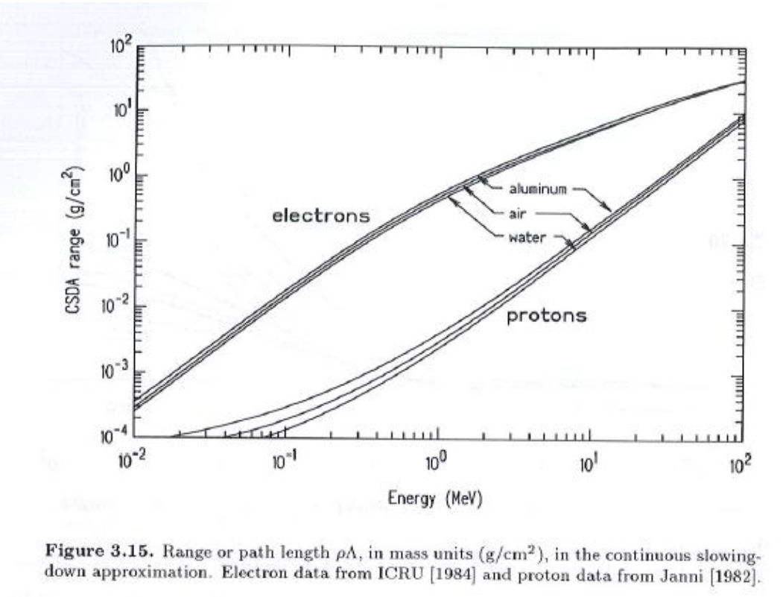
Source Definition: SDEF Card

Slide 2
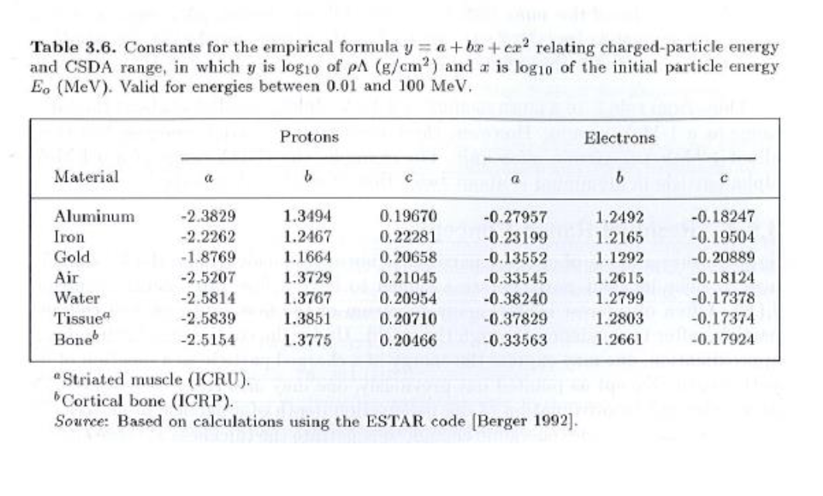

Slide 3
Source Definition: SDEF Card
SDEF card
For a point source:
  PAR=1/2/3 particle type (1/2/3=n/p/e)
  ERG=xx Energy of particle (MeV)
  POS=x y z Position indicator
Example: 9.5 MeV neutron source at point (1., 4., 5.)
SDEF PAR=1 ERG=9.5 POS=1 4 5

Slide 4
Advanced Source Specification
  Source distributions
  Volumetric sources
  Surface sources
  Energy-dependent binning

Slide 5
X axis of a distribution: SI
Syntax:
Description: The SIn and SPn cards work together to define a pdf to select a variable from.
option= blank or H→histogram
=L→discrete
=A→(x,y) pairs interpolated
=S→other distribution #’s
MCNP5 Manual Page: 3-61

Slide 6
Y axis of a distribution: SP
Syntax:
Description: Specification of y axis of pdf for distribution n.
option=blank→completes SI
=-p→predefined function
The P values are the y-axis values OR the parameters for the desired function p—and the SI numbers are the lower and upper limits. (Table 3.4)
MCNP5 Manual Page: 3-61

Slide 7
Examples
SI2 H 0 5 20
SP2 0 1 2
…
SI3 L 1 2
SP3 1 2
…
SI4 A 0 5 20
SP4 0 1 2
…
SI5 1 5
SP5 –21 2

Slide 8
Input shortcuts
Description: Saving keystrokes
MCNP5 Manual Page: 3-4
Syntax:
  2 4R => 2 2 2 2 2
  1.5 2I 3 => 1.5 2.0 2.5 3.0
  0.01 2ILOG 10 => 0.01 0.1 1 10
  1 1 2M 3M 4M => 1 1 2 6 24
  1 3J 5.4 => 1 d d d 5.4
    (where d is the default value for that entry)

Slide 9
Source description variables
Commands:
  POS=Position of a point of interest
  RAD=How to choose radial point
  AXS=Direction vector of an axis
  EXT=How to choose point along a vector
  X,Y,Z=How to choose (x,y,z) dimensions
  VEC=Vector of interest
  DIR=Direction cosine vs. VEC vector
Combinations:
  X,Y,Z: Cartesian (cuboid) shape
  POS, RAD: Spherical shape
  POS, RAD, AXS, EXT: Cylindrical shape
  VEC,DIR: Direction of particle

Slide 10
  X,Y,Z: Cartesian (cuboid) shape
Rectangular source
c *********************************************************************
c *
c Cells *
c *
c *********************************************************************
1 0 -1 imp:n=1
999 0 1 imp:n=0
c *********************************************************************
c *
c Surfaces *
c *
c *********************************************************************
1 sph 0 0 0 20
c *********************************************************************
c *
c Data cards *
c *
c *********************************************************************
mode n
sdef x d1 y d2 z d3
si1 h -5 5
sp1 0 1
si2 h -5 5
sp2 0 1
si3 h -5 5
sp3 0 1

Slide 11
  POS, RAD: Spherical shape
Spherical source
c *********************************************************************
c *
c Cells *
c *
c *********************************************************************
1 0 -1 imp:n=1
999 0 1 imp:n=0
c *********************************************************************
c *
c Surfaces *
c *
c *********************************************************************
1 sph 0 0 0 20
c *********************************************************************
c *
c Data cards *
c *
c *********************************************************************
mode n
sdef pos 0 0 0 rad d1
si1 0 5
sp1 -21 2

Slide 12
  POS, RAD, AXS, EXT: Cylindrical shape
Cylindrical source
c *********************************************************************
c *
c Cells *
c *
c *********************************************************************
1 0 -1 imp:n=1
999 0 1 imp:n=0
c *********************************************************************
c *
c Surfaces *
c *
c *********************************************************************
1 sph 0 0 0 20
c *********************************************************************
c *
c Data cards *
c *
c *********************************************************************
mode n
sdef pos 0 0 0 ext d1 axs 0 0 1 rad d2
si1 -5 5
sp1 0 1
si2 0 5
sp2 -21 1

Slide 13
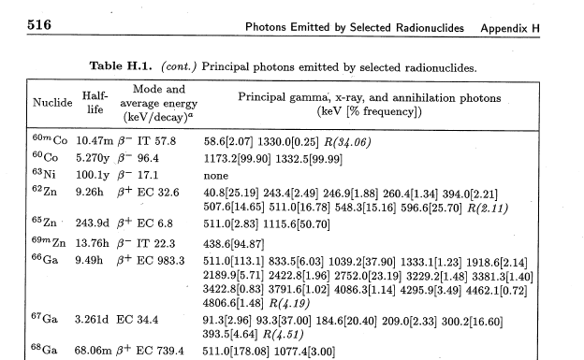
  Appendix H

Slide 14
  HW 4.1
Use the Appendix H data to give me the appropriate MCNP source description for an isotropic 1 microCurie Co-60 point source that is 10 years old.
Use a hand calculation to find the total flux at a distance of 100 cm
Check your flux calculation with an MCNP calculation using an F2 tally

Slide 15
  HW 4.2
Use an MCNP calculation of a beam impinging on the small water sample to estimate the total cross section of water for 0.1 MeV, 1 MeV, and 10 MeV photons. Compare your answers to the values in Appendix C of the text.

Slide 16
  HW 4.3
If you have a parallelepiped volumetric isotropic source with a strength of 100 particles/cc/sec and W=20 cm (x dimension), L=10 cm (y dimension), H=50 cm (z dimension):
Find the equivalent surface source if the analyst judges that L is insignificant.
Find the equivalent line source if the analyst judges that W is also insignificant; and
Find the equivalent point source if the analyst judges that H is insignificant as well.
For each of these be sure the source size, placement and strength (in appropriate units) is specified.

Slide 17
  HW 4.3 (cont’d)
Use MCNP to model each of the sources (3D, 2D, 1D, point) and compare the total flux centered a distance of 250 cm away from the W-H plane. Use an F5 tally.

