Slide 1
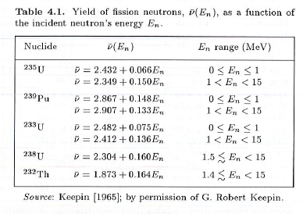

Slide 2
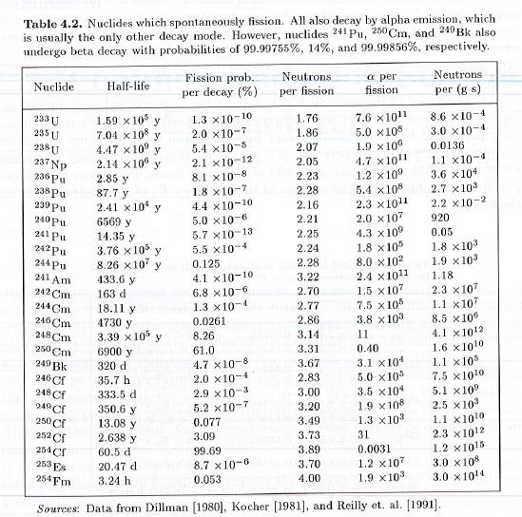

Slide 3
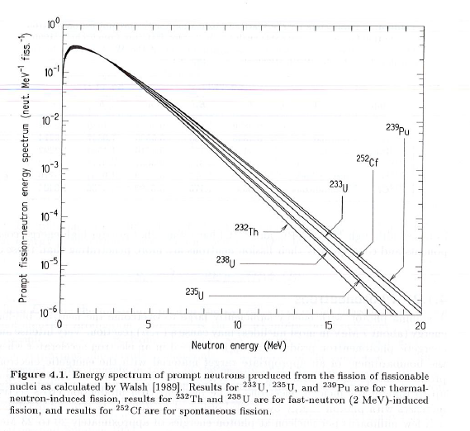

Slide 4
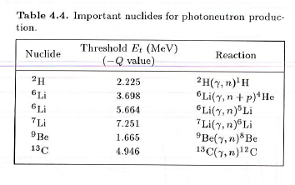

Slide 5
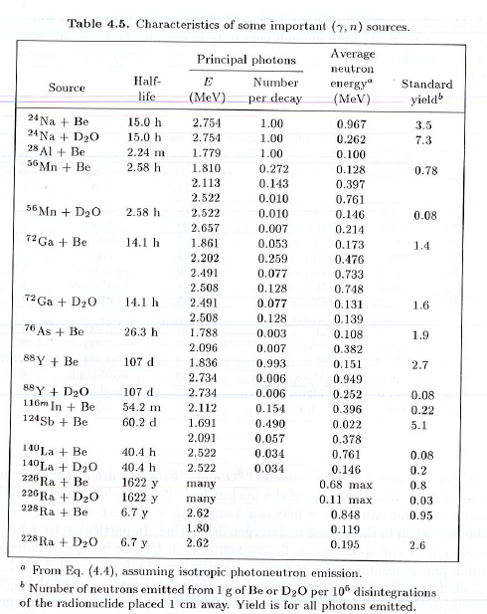

Slide 6
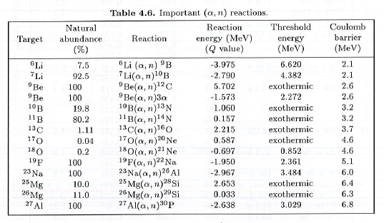

Slide 7
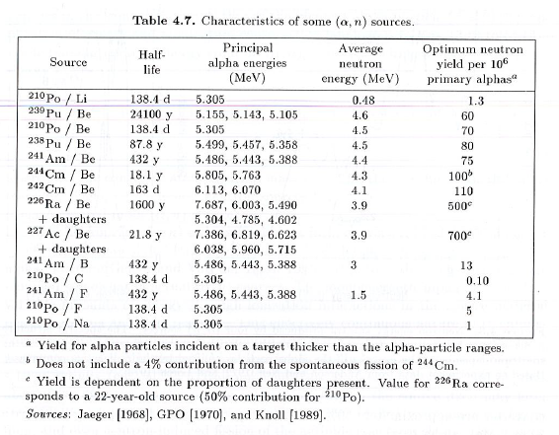

Slide 8
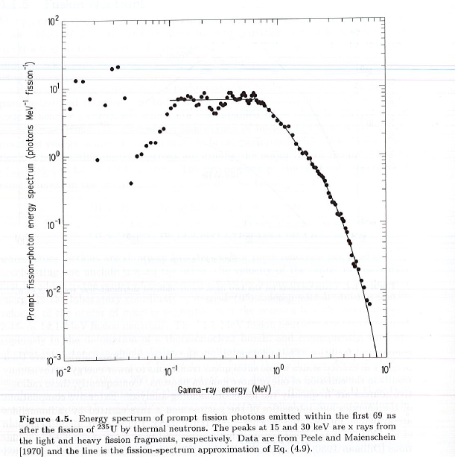


Slide 9
Lecture 5: Charged particles
More involved source spatial descriptions
Source distributions (SI, SP)
New MCNP command:
  En
  Interpolation: xxi
Vised skills:
  Plotting source points
  Plotting cross section

Slide 10
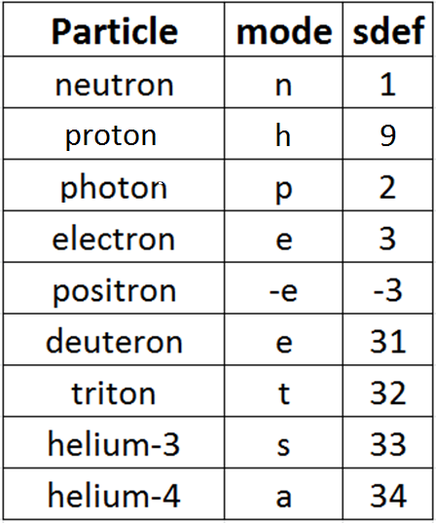
MCNP6 particles (subset!)

Slide 11
Energy bins: En
Syntax:
Description: Create energy UPPER ranges from LOW to HIGH
MCNP5 Manual Page: 3-96

Slide 12
VisEd skill: Plotting source points
Create the input file
Open VisEd to view the geometry
  Zoom in or out/translate axis as desired to give you the view you want
  Click anywhere inside the view you want to source particles to appear in
Under the main toolbar “Particle display” choose “Plot Particle Tracks”
  A window of choices will pop up
  Move the new popup window out of the way, if you want
  Choose:
    Number of particles to plot: Play with this to get the density of particles you want
    Distance from plot plane: This is how far off the plane the particle can be (into or out of the screen) and still be plotted
    Display: Source (For this exercise only. You can make other choices to see collisions, etc.)
  Click on “Plot_Source” on popup toolbar
  Example: EX3A

Slide 13
VisEd skill: Plotting cross sections
Create input file
Open VisEd
Click toolbar “Cross Section Plots”
  A popup window will appear
Click “Read_Cross_Sections” from popup toolbar
Beside “Nuclide” (you could also plot material cross sections using “Material”):
  Enter a number in the box and press “Plot”
  It will NOT plot anything, but the error message will tell you which “zaids” it knows about
  Pick the one you want and type it into the box (including any suffix, e.g., “.70c”)
From the pull-down menu that is under the “Nuclide” box (it probably says “1 Total (N)” in it) and pick the reaction you want it to plot
  Absorption is way down the list at 101
  Photon cross sections start at 501
  The inelastic neutron cross sections start at 51
Press “Plot” again. It will show up in the active window
Example: EX4A

Slide 14
Set up a Mesh Tally
  This is a mesh of rectangles (you can also do a cylindrical mesh) that the answer will be collected on.
This uses the FMESH card, with the following syntax:
FMESHx4:n ORIGIN x0 y0 z0 IMESH x1 IINTS nx
JMESH y1 JINTS ny KMESH z1 KINTS nz
OUT ij
where:
    (x0,y0,z0) is the lower left corner of the mesh
    (x1,y1,z1) is the upper right corner of the mesh
    nx,ny,nz tell how many divisions there are in the mesh in the 3 dimensions
    OUT ij indicates that you want an (x,y) grid of points (for each z level)
    (You can use other combinations (e.g., jk would give you a (y,z) grid for each x level)

Slide 15
  HW 5.1
For each of the four sources in problem HW 4.3 problem (the original cuboid + the three bulleted approximations) create the source in MCNP—with the origin at the center of the original cuboid—and compute the fluxes at the point (250,0,0) using an F5 tally (no material in the problem).
For each of these, also produce a flux tally and create an (x,y) plot, using:
x (-200,200) with 40 divisions
y (-200,200) with 40 divisions
z (-5,5) with 1 divisions

Slide 16
  HW 5.2
Use Table 3.6 to find the range of a 20 MeV proton in Al. Check it with Figure 3.15.
Repeat the problem using MCNP6.

Slide 17
  HW 5.3
We are fond of saying that alpha particles are “stopped” by a piece of paper. Use Table 3.6 (with corrections) to determine the energy of an alpha particle that would have a range of 0.2 cm in water.
Repeat the problem using MCNP6.

