Slide 1
Lecture 6: Preparing for the project
Miscellaneous items to prepare for the project

Slide 2
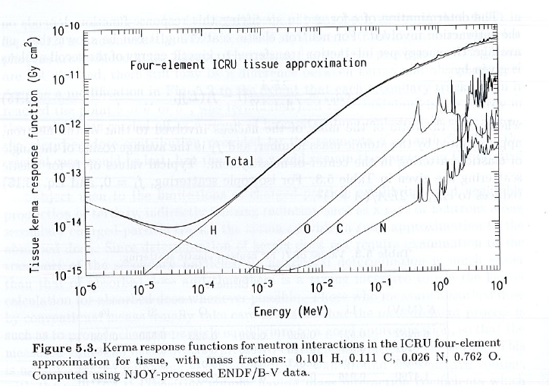
Kerma response functions for ICRU

Slide 3
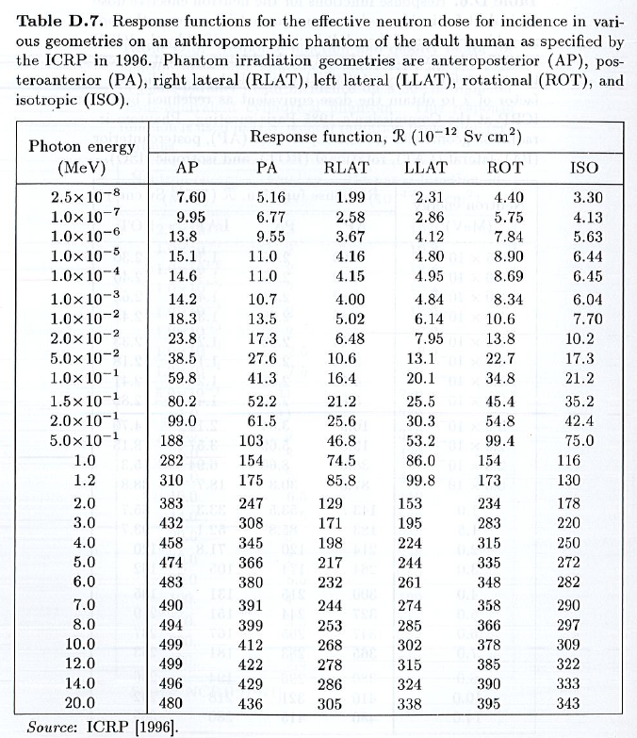
Response functions

Slide 4
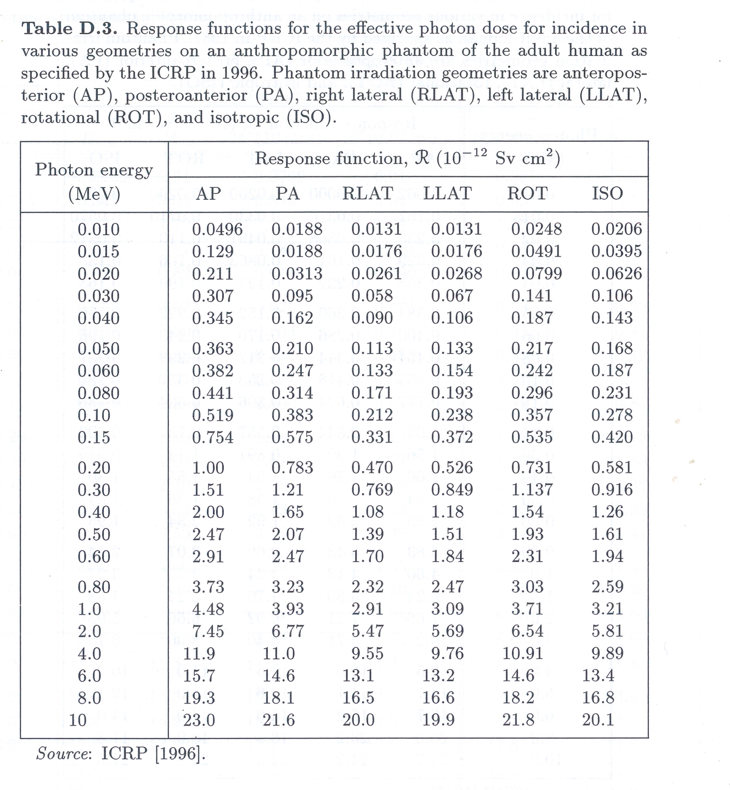
Response functions

Slide 5
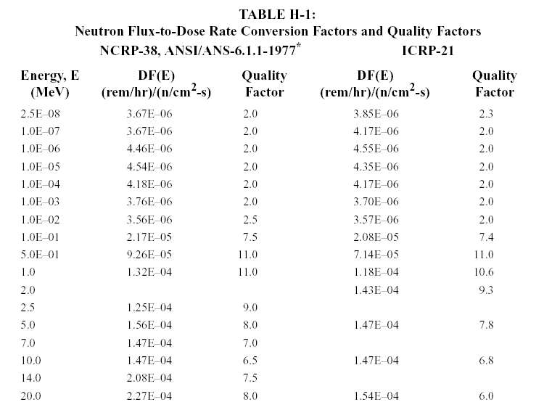
ANSI/ANS Dose Response Functions

Slide 6
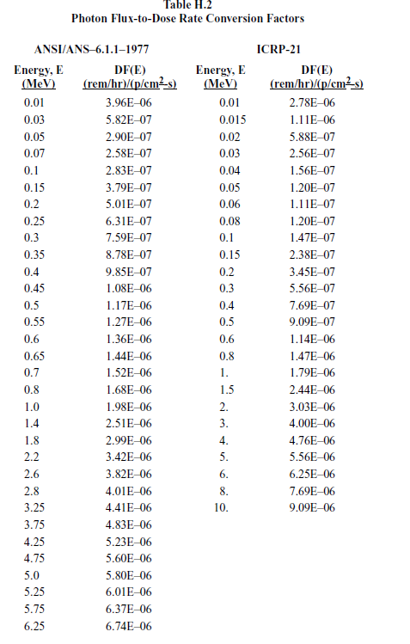
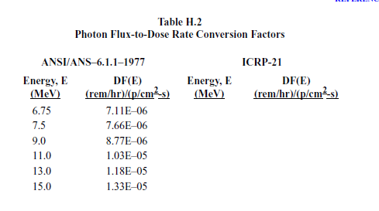
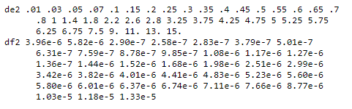
ANSI/ANS Dose Response Functions
DEDF.txt in Public area

Slide 7
Multiplier/cross section response: FM
Syntax:
Description: Provides a constant multiplier to be applied to the tally. Since Monte Carlo is normally done on a per-particle basis, this allows you to include a source strength (or units change). Other use is to put in cross-section dependent response functions to make a tally keep up with particular reaction rates.
MCNP5 Manual Page: 3-93

Slide 8
Set up a Mesh Tally
  This is a mesh of rectangles (you can also do a cylindrical mesh) that the answer will be collected on.
This uses the FMESH card, with the following syntax:
FMESHx4:n ORIGIN x0 y0 z0 IMESH x1 IINTS nx
JMESH y1 JINTS ny KMESH z1 KINTS nz
OUT ij
where:
    (x0,y0,z0) is the lower left corner of the mesh
    (x1,y1,z1) is the upper right corner of the mesh
    nx,ny,nz tell how many divisions there are in the mesh in the 3 dimensions
    OUT ij indicates that you want an (x,y) grid of points (for each z level)
    (You can use other combinations (e.g., jk would give you a (y,z) grid for each x level)

Slide 9
Set up a Mesh Tally (2)
  The mesh itself is put into a file that has ..msht added to your file name
    This is if you use the name=file syntax to run MCNP6. Otherwise look for it among the newer files created.
  This is how I generally view it in EXCEL:
    Open EXCEL
    Open the mesh tally file using an editor that you can cut-and-paste from
    Go to the line just under the “Tally results” line and copy the entire grid into the EXCEL file
      Be aware that it may put each row in a SINGLE cell in the column. If so, highlight the column and use “Data” and “Text to columns” and “Finish” to spread out the rows.
      You also may need to move the ROW of x-dimensions over 1 space to the right
    Highlight (grab) the entire table from the upper left hand corner to the lower right (including the x and y coordinates)
    Choose “Insert” “Other charts…” and any of the Surface plots
    I like to use “Layout” “Axes” “Primary Vertical Axis” to:
      Change to a logarithmic scale with Base 2 or Base 10 (depending on what looks best)
      Set the color ranges so the colors represents factors of 2 or 10
    I also like to click on “3D Rotation” and play with the view (although I also like the “straight down” view using the colors as 2D isoflux lines

Slide 10
Set up a Mesh Tally (3)
    Test of FMESH tally
    c cells
    1 0 -1 2
    2 1 -11.35 -2
    999 0 1
    c surfaces
    1 sph 0 0 0 1000
    2 rpp 50 55 -100 100 -100 100
    c data
    mode p
    sdef erg=2 pos = 0 0 0 par=2
    fmesh4:p origin -500 -500 -1 imesh 500 jmesh 500 kmesh 1
    iints 40 jints 40 kints 1 out ij
    imp:p 1 1 0
    m1 82000 1

Slide 11

Set up a Mesh Tally (4)

Slide 12
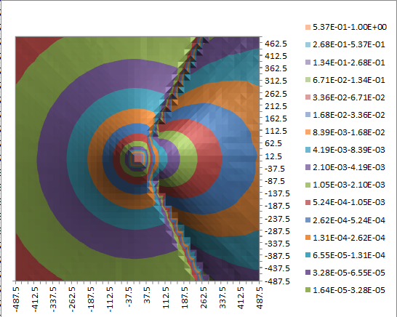
Set up a Mesh Tally (5)

Slide 13
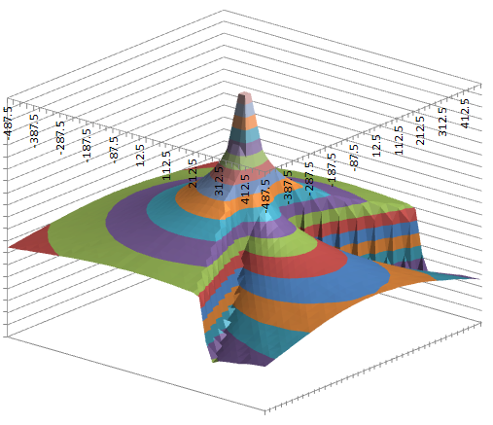
Set up a Mesh Tally (6)

Slide 14
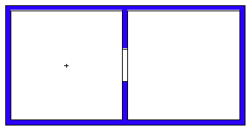
  HW 6.1
Give me a source-height neutron flux map from a 5 MeV neutron point source in the center of a 10’x10’x10’ room.
There is an identical room (through an intervening wall) next to the room the wall is in. Put in a 3 ft wide void opening in the middle of the wall (floor to ceiling).
Assume that the walls are 6” thick water (1 g/cc).
This is the xy view (the + is the source):

