Slide 1
Lesson 1: Introduction
Overview
  Go over the syllabus
  Go over the schedule
  How evaluated
Course philosophy
Importance of criticality safety out there
Get SCALE
Think like a neutron

Slide 2
Course workload
How you are evaluated
  Two tests on text material
  Report on historical criticality accident
  Practice on a computational NCSE
Good practical experience for resume:
  Familiarity with a specialized vocabulary
  Knowledge of ANS standards
  SCALE experience
  An NCSE under your belt

Slide 3
Course philosophy
This is a PROFESSIONAL course [special terms]
  How a particular corner of nuclear work does its thing
  Not so much theory as in other courses, but pulling together theory from other disciplines to get a job done
  The unusual (and valuable) part of NCS is the people side [table top]
Goals:
  Learn what criticality safety is and how it is performed in the real world
  Learn the terminology and be able to discuss it rationally (midterm)
  Learn how to run SCALE for criticality problems
  Learn about NCSE’s: What they are, how they are made, experience in writing one
  Get a head start on a Qual Card

Slide 4
KSA
Delving a bit too much into “pedagogical theory,” achieving mastery of a profession involves mastering 3 elements:
  Knowledge: Facts you must know (most engineering classes)
  Skills: Tasks you must be able to do (sometimes included as projects/internships)
  Attitude: How the profession approaches problems [Paper Chase]. What stories are told?
This course, unusually, covers all three elements. [Best part is the stories]

Slide 5
Importance of CS “out there”
Unreactor: Most situations in NE we do NOT want criticality to occur
Main standard is entitled “Nuclear Criticality Safety in Operations with Fissionable Material Outside Reactors”
Consequences of a criticality accident
  Loss of life
  Loss of money
  Loss of control

Slide 6
Definitions of Criticality Safety
The prevention or termination of inadvertent nuclear chain reactions in nonreactor environments
The art of avoiding a criticality excursion
Protection against the consequences of …

Slide 7
NCS practice
Integration of:
  Neutron physics (reactor physics)
  Engineering design processes (chemical)
  Human factors—Both us and them (evaluators and operators)
Historical trends:
  1940s-50s: Expanding production beyond safety philosophy
  1960s-70s: Recognition of need for more formal approach
  1980s-present: Extreme conservatism

Slide 8
Introductory thoughts (2)
Related to reactor theory, but
  No burnup per se
  No transient study
  More diverse geometries
  MUCH higher dependence on neutron leakage
Hot job and consulting market right now
  If you have experience—Getting in the door is not quite as easy [Y-12]
  Crit safety is a pretty small world [ANS mtgs]
Good basic background for going into related areas: Shielding, reactor apps.

Slide 9
Introductory thoughts (3)
Oak Ridge is a center of activity: X-10 for methods, X-10/K-25/Y-12 for practice
My experience is at Savannah River, Rocky Flats, Yucca Mountain, NFS (Erwin, TN), Portsmouth GDP, USEC, Y-12
  Much of the course content will reflect this
Controversy in field:
  “Black box” code use vs. experimental and handbook evaluations
  Overall training standards: ANSI/ANS 8.26

Slide 10
Get SCALE soon
Go to RSICC website
Customer service
  Registration : Fill it out
    Company name: University of Tennessee
    Organization type: University
    Project type: Criticality Safety
    Funding source: US University 100%
  Request form
    SCALE 6.x or SCALE 6.x-EXE

Slide 11
Think like a neutron
What separates good NCS engineers from great NCS engineers is to see a situation
  Understand the process being evaluated
  Understand the risks by understanding how neutrons behave
  This gives you credibility because you can explain why different rules are in place without having to look them up
  NOT having to say: “Wait, let me calculate that” [8.26 hands-on course]

Slide 12
Criticality: Neutron balance
Critical configuration: Neutron PRODUCTION from fission exactly balances neutron LOSS from absorption and leakage
How do we hold k-effective down? (Answer=use an eigenvalue)

Slide 13
Criticality: Neutron balance (2)
Our focus is a little different from reactor physics because we are much more influenced by LEAKAGE
In this regard, we are much closer to Fermi, et al., because of the UNIQUENESS of our situations and our strong dependence on SIZE and SHAPE of the system being considered

Slide 14
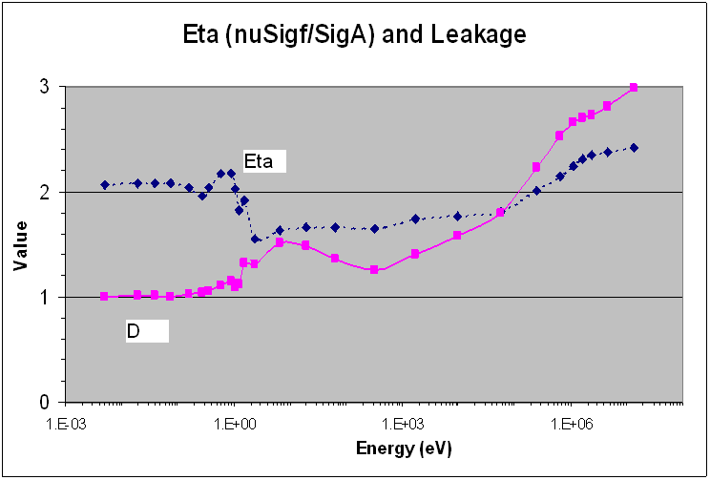
U-235 Sphere

Slide 15
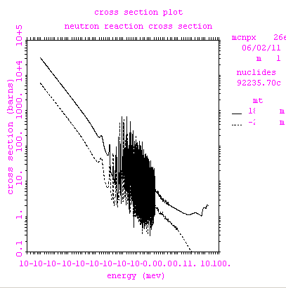

Slide 16
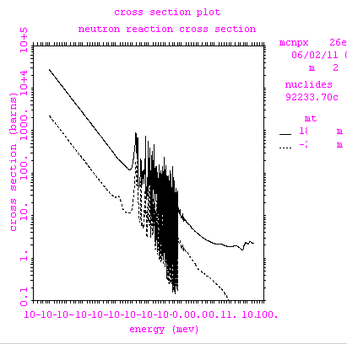

Slide 17
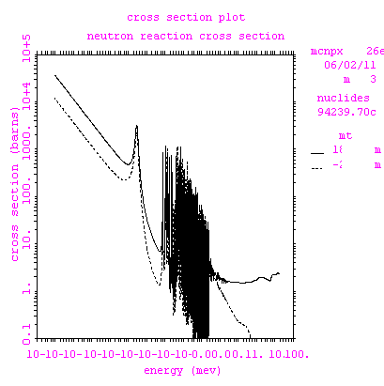

Slide 18
