Slide 1
Lesson 3: Hand calculations
Review: MAGICMERV
Buckling equivalence method
Areal density concept
Surface density method

Slide 2
Review: MAGICMERV. Which ones can stand alone?
M
A
G
I
C
M
E
R
V
2

Slide 3
Hand calculation methods
Buckling shape conversion
Surface density method (not studied)
Analog density method (not studied)
Solid angle method (not studied)
Usefulness:
  Analyst: Starting point for your model
  Analyst/Reviewer: Approximate check of results

Slide 4
Buckling equivalence
From one-speed diffusion theory, we have:
which (ultimately) gives us:

Slide 5
K-effective
Re-arranging and integrating over all volume:
So:
  (Roughly) For a given material, the integrals will all increase and decrease proportionally.
  The bigger B² is, the LOWER k-effective is
  (Roughly) For a given material, two unit shapes with the same B² will have the same k-effective

Slide 6
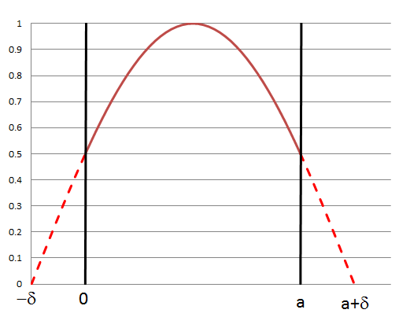
Buckling equivalence (2)

Slide 7
Buckling equivalence (2)
For different geometric arrangements, the buckling reduces to Table 8-I in text:
  Sphere of radius r
  Cylinder (r,h)
  Cuboid (a,b,c)
Use δ=2 cm (bare) or δ=5 cm (H2O reflected) if better information not available

Slide 8
Buckling equivalence (3)
Sample problem:
  You have determined a volume limit of 10 liters for a cylinder with a H/D ratio of 2.5.
  What would be the volume of a sphere with the same k-effective?
  Answer: 5.2 liters

Slide 9
Homework
Homework 3-1
You fill a shoebox (15 cm x 20 cm x 30 cm) with a fissile solution and find that it is exactly critical. What would be the approximate radius of a critical sphere of the same material? (Ans. = 11.645 cm)

Slide 10
Homework
Homework 3-2
It is common practice to assume that a cylinder with a height/diameter ratio of 1.00 has the highest reactivity (lowest buckling). Use your calculus to show that based on the formula (ignoring the extrapolation distance), the actual value for the most reactive H/D (for fixed volume) is 0.924.
(You may use a spreadsheet to show that this is optimum.)

