Slide 1
Lesson 5: ANSI/ANS standards

Slide 2
Organizations
American National Standards Institute (ANSI)
  Promulgation of standards
  Nation’s point guard for international standardization (ISO)
ANS
  American Nuclear Society
  Joint numbers with ANSI

Slide 3
Key points
ANSI does NOT create the standards
  They pick the professional organization responsible for the development
  They regulate the “process” for:
    Wide enough participation
    Consensus-following
  Then they bless them

Slide 4
Key points (2)
ANS:
  Solicits volunteers to be on the:
    Standards-creating committees: One committee for each standard
    Oversight committees
  Sells the standards

Slide 5
Key points (3)
The committee for each standard:
  Writes the standard
  Solicits broad comments
  Recommends for issuance once it is ready
  Argues a LOT
The ANS oversight committee(s)
  Decides when new standards are needed
  Creates the committees
  Makes sure the rules are followed

Slide 6
ANS-8 standards
ANS-8.1: Nuclear Criticality Safety in Operations with Fissionable Materials Outside Reactors
ANS-8.3: Criticality Accident Alarm System
ANS-8.5: Use of Borosilicate-Glass Raschig Rings as a Neutron Absorber in Solutions of Fissile Material

Slide 7
ANS-8 standards (cont’d)
ANS-8.6: Safety in Conducting Subcritical Neutron-Multiplication Measurements In Situ
ANS-8.7: Guide for Nuclear Criticality Safety in the Storage of Fissile Materials
ANS-8.9: Nuclear Criticality Safety Criteria for Steel-Pipe Intersections Containing Aqueous Solutions of Fissile Materials
ANS-8.10: Criteria for Nuclear Criticality Safety Controls in Operations With Shielding and Confinement

Slide 8
ANS-8 standards (cont’d)
ANS-8.12: Nuclear Criticality Control and Safety of Plutonium-Uranium Fuel Mixtures Outside Reactors
ANS-8.14: Use of Soluble Neutron Absorbers in Nuclear Facilities Outside Reactors
ANS-8.15: Nuclear Criticality Control of Special Actinide Elements

Slide 9
ANS-8 standards (cont’d)
ANS-8.17: Criticality Safety Criteria for the Handling, Storage and Transportation of LWR Fuel Outside Reactors
ANS-8.19: Administrative Practices for Nuclear Criticality Safety
ANS-8.20: Nuclear Criticality Safety Training
ANS-8.21: Use of Fixed Neutron Absorbers in Nuclear Facilities Outside Reactors

Slide 10
ANS-8 standards (cont’d)
ANS-8.22: Nuclear Criticality Safety Based on Limiting and Controlling Moderators
ANS-8.23: Nuclear Criticality Accident Emergency Planning and Response
ANS-8.24: Validation of Neutron Transport Methods for Nuclear Criticality Safety Calculations
ANS-8.26 Criticality Safety Engineer Training and Qualification Program
ANS-8.27 Burnup Credit for LWR Fuel

Slide 11
ANS-8.1: Nuclear Criticality Safety in Operations with Fissionable Materials Outside Reactors
Granddaddy of them all
  All others are just extensions of this one
  Mixture of philosophy, rules, and data
  So important we will give it special emphasis

Slide 12
Structure of ANSI/ANS-8.1
Introduction: Paragraph of basic need
Scope: What it is used for, NOT used for
Definitions:
  Limitations
  Shall, should, may
  Glossary of terms
    Area of applicability
    Areal density
    Bias
    Calculational method

Slide 13
Structure of ANSI/ANS-8.1
Nuclear Criticality Safety Practices
  Administrative practices
  Technical practices
  Validation of a calculational method
Single-parameter limits for fissile nuclides
  Uniform aqueous solutions
  Aqueous mixtures
  Metallic units
  Oxides
Multiparameter control
References

Slide 14
Principles from ANSI/ANS-8.1
Applicable to operations with fissionable material outside nuclear reactors [1]
“Shall” vs. “Should” vs. “May” [3.2]
Need for analysis: “Before a new operation with fissionable material is begun, or before an existing operation is changed, it shall be determined that the entire process will be subcritical under both normal and crdible abnormal conditions” [4.1.2]
“Nuclear criticality safety is achieved by controlling one or more parameters of the system within subcritical limits and by allowances for process contingencies.” [4.2]

Slide 15
ANSI/ANS-8.1 (cont’d)
“All controlled parameters and their limits shall be specified” [4.2.1]
“Double contingency principle. Process designs should incorporate sufficient factors of safety to require at least two unlikely, independent, and concurrent changes in process conditions before a criticality accident is possible.” [4.2.2]
  No single mishap - regardless of probability - can result in criticality
  Criticality requires two unlikely, independent, concurrent changes [flooding, number]
  Requires common sense regarding “unlikely” [1 in 100 years]. Site specific

Slide 16
ANSI/ANS-8.1 (cont’d)
Preference order [4.2.3 & 4.2.4]
  Geometry
  Neutron absorber [credit taken]
  Administrative (procedural)
Subcritical limit [3.3 & 4.2.5]
  “Limiting value assigned to a controlled parameter under specified conditions”: single-parameter vs. multi-parameter
  Assures that subcriticality maintained
  “Subcritical limits shall be established on bases derived from experiments, with adequate allowance for uncertainties in the data.”

Slide 17
ANSI/ANS-8.1 (cont’d)
Validation of methods (and data)
  Establishment of bias: “Bias shall be established by correlating the results of critical and exponential experiments with results obtained for these same systems by the calculational method being validated.” [4.3.1]
  Bias uncertainties: “The uncertainty in the bias shall contain allowances for uncertainties in the experimental conditions, for lack of accuracy and precision in the calculational method and for extension of the area (or areas) of applicability.” [4.3.3]
Verification: “If the method involves a computer program, checks shall be performed to confirm that the mathematical operations are performed as intended.” [4.3.4]

Slide 18
Administrative practices
Safety responsibility and criteria established by management
Process analysis including effects of credible abnormal conditions
Written procedure
Controlled movement of material
Prompt reporting
Frequent independent operational reviews
Emergency procedures/training

Slide 19
Single and multiple-parameter limits
The standard includes limits that can be used
Example: Table 1, “Single parameter limits for uniform aqueous solutions of fissile nuclides:
  Rows: Mass, cylinder diameter, slab thickness, solution volume, concentration of fissile nuclide, H/U ratio, areal density
  Columns: ²³³UO₂F₂, ²³³UO₂ (NO3) ₂, ²³⁵UO₂F₂, ²³⁵UO₂ (NO₃) ₂, ²³⁹Pu (NO₃) ₄
Other single: U235 enrichment limits, Metal limits (mass, enrichment, diameter, thickness)
Multiple parameter limits: Mass vs enrichment, Volume vs. enrichment, Radius vs. enrichment

Slide 20
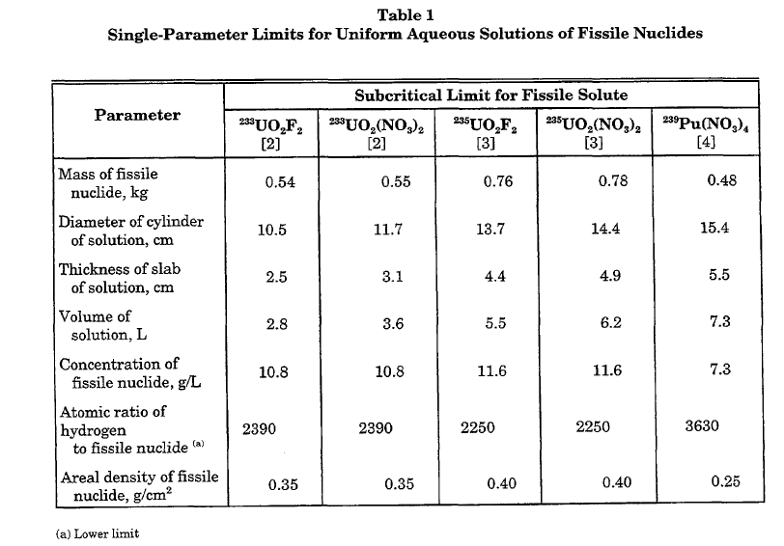
Single and multiple-parameter limits

Slide 21
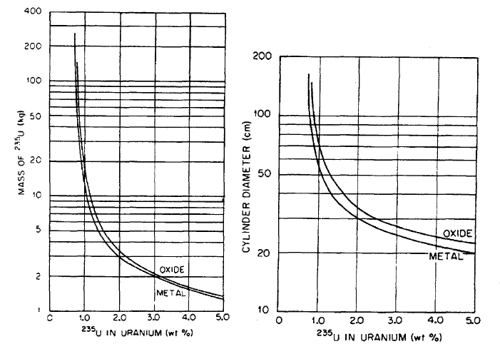
Single and multiple-parameter limits

Slide 22
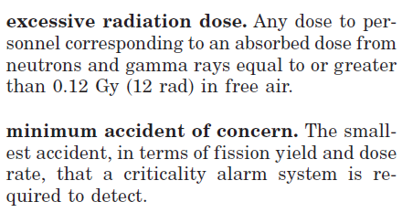
ANS-8.3: Criticality Accident Alarm System
Establishes need and rules for an alarm system to detect criticality events
Definitions:

Slide 23
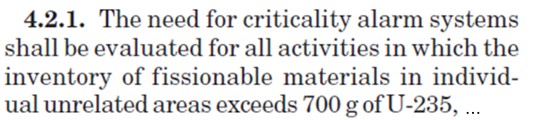
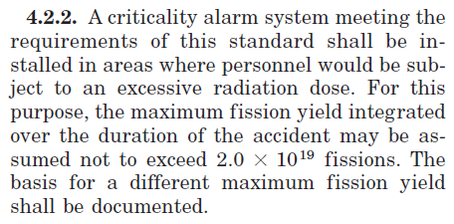
ANS-8.3: Criticality Accident Alarm System
Rules:

Slide 24
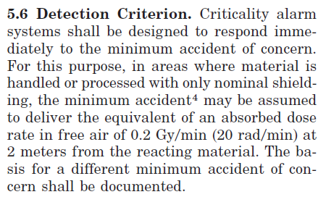
ANS-8.3: Criticality Accident Alarm System
Rules: (cont’d)

Slide 25
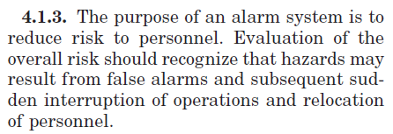
ANS-8.3: Criticality Accident Alarm System
Rules: (cont’d)

Slide 26
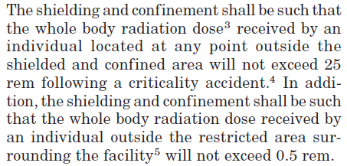
ANS-8.10: Criteria for Nuclear Criticality Safety Controls in Operations With Shielding and Confinement
Establishes the reduced requirements of a system that is shielded.
Rules:

Slide 27
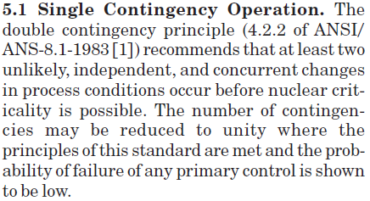
ANS-8.10: Criteria for Nuclear Criticality Safety Controls in Operations With Shielding and Confinement
Rules: (cont’d)

Slide 28
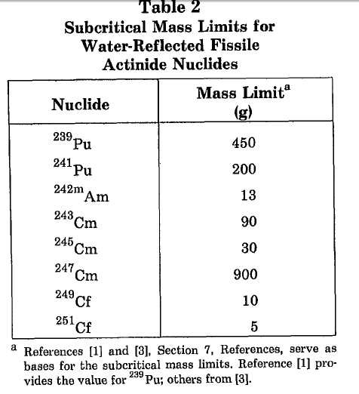
ANS-8.15: Nuclear Criticality Control of Special Actinide Elements

Slide 29
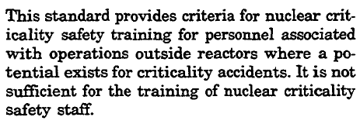
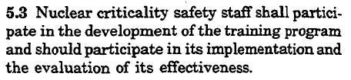
ANS-8.20: Nuclear Criticality Safety Training
Scope:
Rules:
Description of content provided in standard

Slide 30


ANS-8.24: Validation of Neutron Transport Methods for Nuclear Criticality Safety Calculations
Establishes the minimum requirements to use a calculational method to determine subcriticality
Definitions:

Slide 31


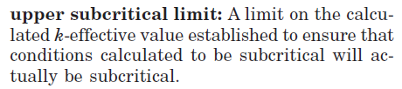
ANS-8.24: Validation of Neutron Transport Methods for Nuclear Criticality Safety Calculations
Definitions: (cont’d)

Slide 32
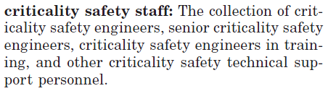
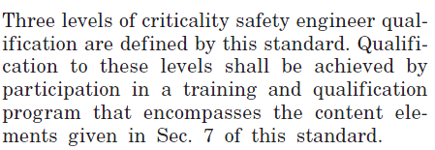
ANS-8.26 Criticality Safety Engineer Training and Qualification Program
Establishes criteria for training crit safety engineers
Definitions:

Slide 33
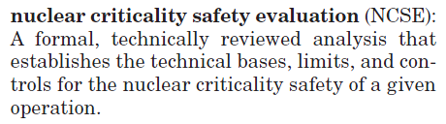
ANS-8.26 Criticality Safety Engineer Training and Qualification Program
Definitions: (cont’d)

