Slide 1
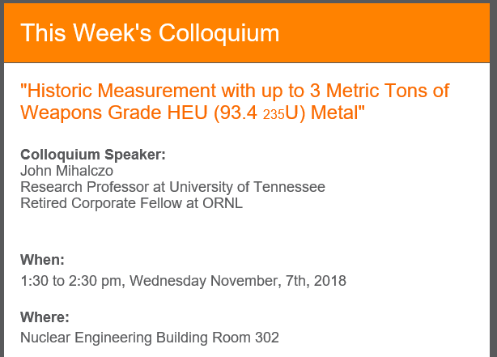

Slide 2
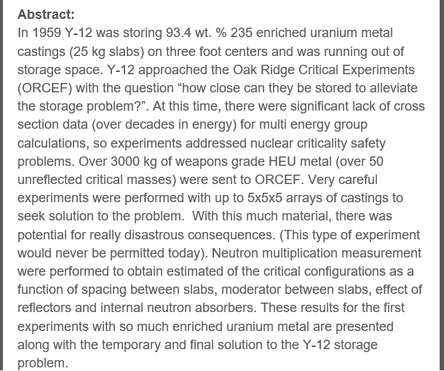

Slide 3
Lesson 8: Prep for Test#2
Descriptive, Contingency analysis

Slide 4
New public file entries
Project assignments
Test#2 (takehome)
Accident report assignments

Slide 5
Cover sheet
Strict format: see example
Evaluation is YOUR first three initials plus -01
  Be sure to change the header to agree (all WORD section!)
Title should distinguish it from all the others in the same overall task.
  Title should say what is being stored where

Slide 6
Outline of Typical CSE
Introduction
Description of process
Computational methodology
Discussion of contingencies
Evaluation and results
Design features and administrative controls
Summary & conclusions
Appendices

Slide 7
Introduction
Why the work is being done
Scope: Exactly what process is being analyzed.
  Where its responsibility starts and ends
Revision history
Necessary administrative boilerplate

Slide 8
Outline of Typical CSE
Introduction
Description of process
Computational methodology
Discussion of contingencies
Evaluation and results
Design features and administrative controls
Summary & conclusions
Appendices

Slide 9
Description of process
Necessary description of the process
  Overview of the procedural steps
  Important interactions with preceding and following processes (and any others)
Necessary description of the hardware
  Gloveboxes, canisters, storage racks, etc. (PICTURE)
  Relative positions, etc. (ROOM PICTURE)
  Special materials
Different variations allowed in geometry and process (i.e., that are important to criticality)
Compare to the Contingency Table to make sure that all of the controlled MAGICMERV parameters are mentioned but do not quote the controlled values of the parameters.

Slide 10
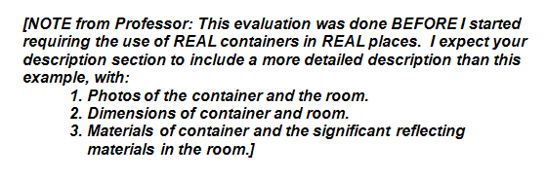
Description of process (1)
From the ExampleCSE:

Slide 11
Outline of Typical CSE
Introduction
Description of process
Computational methodology
Discussion of contingencies
Evaluation and results
Design features and administrative controls
Summary & conclusions
Appendices

Slide 12
Computational Methodology
Non-KENO
  Indication that relying on ANS-8.1 limits and/or hand calculational techniques
KENO
  Indication that relying on criticality calculations+
    Basis of criticality control (USL)
  Description of the codes used (do not copy)
  Description of the computer used (do not copy)
    Point to the (fake) verification document
  Summarize validation (i.e., tell me the USL) and point to the Validation appendix

Slide 13
Computational Methodology (1)
Mention that the basis of criticality safety is…and list the MAGICMERV parameters you are controlling
Point to Section 7 for the controls themselves

Slide 14
Outline of Typical CSE
Introduction
Description of process
Computational methodology
Discussion of contingencies
Evaluation and results
Design features and administrative controls
Summary & conclusions
Appendices

Slide 15
Contingency table
Triple pass through MAGICMERV
Three passes:
  Normal: Ranges of each of the variables NOT DISALLOWED=Expected no more than once in the life of the plant (100 years)
  Contingencies: Ranges of each of the variables in CREDIBLE accident scenarios (roughly 1 in a million years)
  Controls: What backs up your assumptions in previous two columns

Slide 16
Table x. Results of Contingency Analysis
Critical Parameter | Normal | Contingency | Controls
Mass
Absorber
Geometry
Interaction
Concentration
Moderation
Enrichment
Reflection
Volume
16

Slide 17
Discussion of contingencies (2)
Errors in ExampleCSE:
  Mass: Normal and Contingency should have included his actual mass limits (3.1*1.2 and 3.1*1.2*2 kg)
  Geometry: Should have said cylinder
  Enrichment: Normal should have said 100%, not N/A
  Volume: Should have done the math under Normal and said 4.4 L

Slide 18
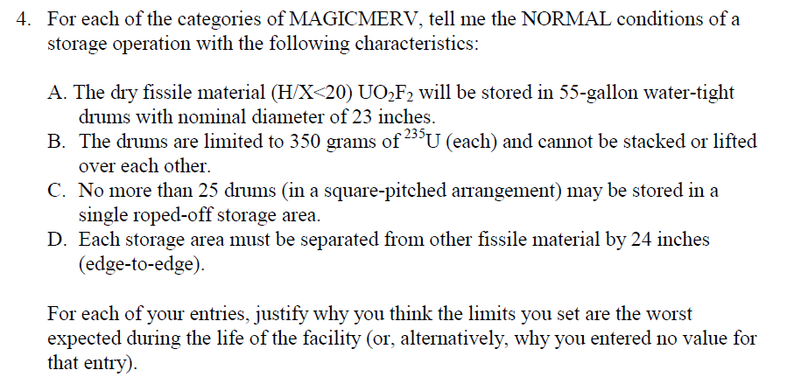
Example #1

Slide 19
Example #2
Consider a desk-top repackaging job utilizing 5-, 10-, and 15-liter containers. Your job is to set the limits.
What sort of limits must be considered?
What other details do you need to know?
What to consider in a normal parameter analysis?
What to consider as accident scenario?

