Slide 1
Lesson 10 Objectives
Chapter 4 [1,2,3,6]: Multidimensional discrete ordinates
  Multidimensional quadratures
  Cartesian (x-y-z) difference equations and solution strategies
  Ray effects

Slide 2
MultiD quadratures
In contrast to the one direction cosine we considered in Chapter 3, multidimensional D.O. use all 3:
In terms of the eight octants of unit directional sphere:
Octant | μ | η | ξ
1 | + | + | +
2 | - | + | +
3 | - | - | +
4 | + | - | +
5 | + | + | -
6 | - | + | -
7 | - | - | -
8 | + | - | -

Slide 3
MultiD quadratures (2)
We have the following relationships between geometry type and octants that must be calculated:
Geometry | Unique octants | Reason
1D slab/spherical | 1,2 (μ only)
1D cylindrical | 1,2 (μ & η) | (same)
2D geometries | 1,2,3,4(μ & η)
3D geometries | All 8 (μ, η, ξ) | No symmetry

Slide 4
MultiD quadratures (3)
Note that 1D cylindrical has an angular dependence like 2D because there is no rotational symmetry about the (one) spatial axis
Again, we will be handling the directional flux dependence with a QUADRATURE: Calculating the angular flux only in particular directions and find the flux moments as weighted sums of these “discrete ordinates”:

Slide 5
MultiD quadratures (4)
Let’s see how quadratures are laid out. First of all, we will assume the quadrature has reflection symmetry
If Octant 1 has a direction , then:
  Octant 2 has the direction
  Octant 3 has the direction , etc.
This is NOT required, but it gives us all the angles needed for reflection B.C.’s and keeps things balanced
It is COMMON for shielding problems to use biased quadratures that have more quadrature directions pointing in a direction of interest

Slide 6
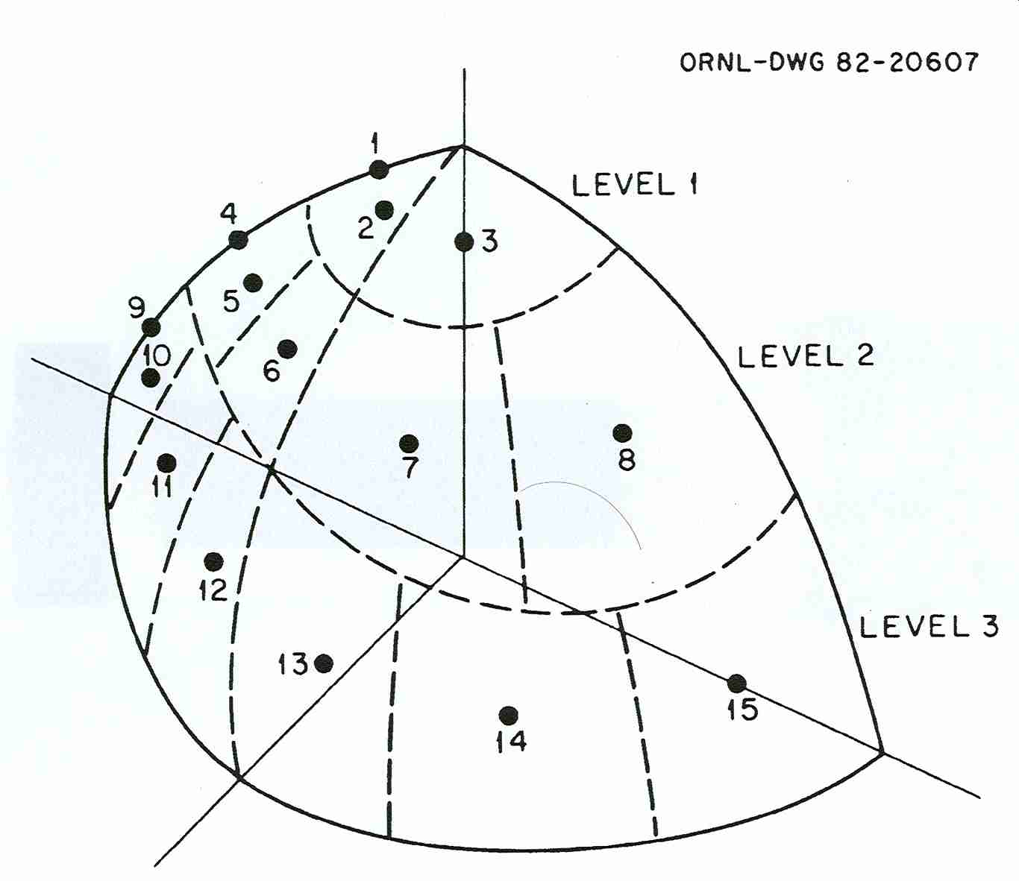
MultiD quadratures (5)
3D quadrature—S?

Slide 7
MultiD quadratures (5)
The normal way of laying out quadratures is the Level Symmetric Quadratures:
Note that the ξ-directions are not drawn, but you should be able to “see” them
Be sure to keep the confusing subscripts straight (I started over with 1 even though we would normally call it μ₅).
η₄
Note the μ and η “levels”
(the ξ-levels are there, too)
S₈ quadrature
η₃
η₂
η₁
μ₁
μ₂
μ₃
μ₄

Slide 8
MultiD quadratures (6)
For Level Symmetric Quadratures (LSQ), the symmetry is extended to include 90 degree rotations as well:
Somewhat surprisingly, there is only ONE degree of freedom in determining a LSQ: Once you choose the value of the first level, μ₁, the rest of the quadrature falls out automatically. Let’s see why.
Assuming that we have a direction that comprises the three levels i, j, and k, we must have:

Slide 9
MultiD quadratures (7)
The key thing to “see” is that if we stay on a given ξ-level symmetry and increase the mu-level by one, then the eta-level has to decrease by one:
If we subtract:
we get:
But, since the mu, eta, and xsi values are all the same:
This means that the differences of the squares of consecutive levels must be some constant, C, that is constant for the quadrature

Slide 10
MultiD quadratures (8)
So, if you know μ₁ and C, you know the others:
Using the one real point we can count on: That the direction closest to the North Pole in our graph HAS to have the lowest μ, the lowest η, and the HIGHEST ξ, therefore:

Slide 11
MultiD quadratures (9)
which can be translated into:
So, after picking a μ₁, we can find C from the above equation, then build the N/2 level values.
With the level values, the actual quadrature comprises all combinations of i, j, and k such that

Slide 12
MultiD quadratures (10)
The only quadrature this does not work for is S₂, for which C is undefined.
For this special case (one direction per quadrature), symmetry demands that:
From the required relation:
we can easily see that:
Interestingly, this is the LARGEST that μ₁ can be since the formula for C is only non-negative if:

Slide 13
MultiD quadratures (11)
Returning to the original octant drawing, we see that the upshot of all this is that the number of μ values in each “eta-level” decreases by 1 for each step we make:
This also works vertically (for xsi-levels), although you cannot see it in the graph. (In looking at the graph, you should imagine that you looking down on point drawn on the first octant of a basketball, e.g., the lower left one is the HIGHEST one. Look at 10-6 again.)
So, how many directions ARE there, total?
η₄
η₃
η₂
η₁
μ₁
μ₂
μ₃
μ₄

Slide 14
MultiD quadratures (12)
Let’s count them:
  There are N/2 directions for 1st “eta-level”
  There are (N-1)/2 directions for the 2nd eta-level.
  …
  There is 1 direction for the (N/2)th eta-level.
For a 3D geometry (the whole basketball), there are 8 octants, so
For 2D (x,y) geometry, we have symmetry up and down, so there is no use calculating the “down” directions:

Slide 15
MultiD quadratures (13)
Once the directions are found, the weights are found with a 3 step process:
All quadrant reflections are restrained to have the same weight:
  This means we only have to worry about the N(N+2)/8 values in the first quadrant.
All permutations of the level subscript numbers have the same weight.
The unique weights that remain are found by either:
  Correctly integrating as many 1D moments as possible (works up to about S₂₀); or
  Associating an area of the unit sphere with each direction (maintaining symmetry) and using ΔΩ as the weight.

Slide 16
Find the equal weights
Take this quadrature (what is its order?) and label with the indices:
Now mark out the directions with the same weight
η₄
η₃
η₂
η₁
μ₁
μ₂
μ₃
μ₄

Slide 17
Find the equal weights (2)
The unique weights that remain are found by:
  Finding the weights for each of the N/2 “levels” to correctly integrate the EVEN 1D moments to order 2(N-1).
  to the highest even moment that you can.
  Solving the linear algebra problem to find the unique weights for the multidimensional directions—which will only have a solution for a particular value of μ₁.
  Repeat Steps 1 & 2, modifying μ₁ to get the NEXT even moment as well.
They say this works up to about S₂₀
  Book only goes to S₁₆
See Table 4-1 in text.

Slide 18
Cartesian difference equations
The spatial differencing for (x,y) geometry is a straight-forward extension of what we did in slab.
Integration of the continuous space equation over a rectangular cell:
gives us:
Cell ij

Slide 19
Cartesian difference equations (2)
Again invoking the cell edge fluxes (this time 4 of them):

Slide 20
Cartesian difference equations (3)
Dividing by the cell volume ΔxΔyΔz gives:

Slide 21
Cartesian difference equations (4)
This gives us 5 unknown fluxes with only 1 equation, which we attack as we did for the slab equation:
  Two of the fluxes are known from previous cells that have been calculated; and
  Two of the fluxes are found from the introduction of auxiliary equations.
The most common auxiliary equations are the 2D equivalents of step, diamond-difference, weighted diamond difference, and characteristic
We will work with diamond difference to show you how the math goes

Slide 22
Cartesian difference equations (5)
Again, average flux from incoming and outgoing.
  This time we can do it in both dimensions:
  which can be rearranged to give:
Substitution gives us:

Slide 23
Cartesian solution strategies
As for 1D, the solution “sweep” strategy consists of beginning at a known boundary and following the particles across the cell
This time there are 4 variations (one for each corner):

Slide 24
Non-Cartesian Equations/Solution Strategies
For curvilinear geometries, we can develop a set of equations that is discretized in direction and space, like we saw in 1D spherical. The resulting relationships are too esoteric for me to force you through.
Basic characteristics you should know are:
The flux in any direction has an additional “linkage” to fluxes in “neighboring” directions.
The only exception to the above is a direction (1 per “eta level”) that has μ=0. (See 10-6 again; they are plotted as 1, 4, and 9.)
Therefore, this “backward” direction must be added to the quadrature (with weight=0) and calculated FIRST to “jump-start” the process
Many general S_{N} quadratures keep these “zero-weight” angles and use them even for Cartesian geometries.

Slide 25
Ray effects
The principal shortcoming of multiD discrete ordinates is the existence of ray effects in some problem flux solutions.
Ray effects show up as non-physical oscillation “waves” in fluxes for regions far away from source regions:
“Source in a corner”

Slide 26
Ray effects (2)
The problem arises, NOT from numerical errors, but from the basic discrete ordinates representation of angular fluxes discretely.
Ray effect “solutions” generally fall into three categories:
  Increase the angular representation in problem directions. This either takes the form of increasing the number of directions or by “biasing” the directions in toward the problem directions.
  Get away from discrete ordinates by using a continuous representation of direction (Spherical Harmonics methods)
  Couple the problem with a first collision source estimator.
The last solution consists of precalculating (i.e., before the DO solution) the uncollided contribution to the response and the spatial, energy, and angle distribution of particles emerging from their FIRST collision.
Then the DO solution uses the (more evenly distributed) first collision source as its external source

Slide 27
Homework 10-1 (in class exercise)
Reproduce the S₆ quadrature from Table 4-1. (Take the μ₁ as given and compute the other values and weights.)

