Slide 1
Lesson 11 Objectives
Begin Chapter 5: Integral Transport
Derivation of I.T. form of equation
Application to slab geometry
Collision probability formulation
Matrix solution methods

Slide 2
Derivation of I.T. form of equation
We now switch our point of view to a different form of the Boltzmann Equation: The Integral Transport Equation
Differs 2 ways from Discrete Ordinates
  1. Uses the integral form of the equation: No derivative terms
  2. The angular variable is integrated out, so the basic unknown is NOT the angular flux, but its integral, the scalar flux:
As in Chapters 3 and 4, we will assume that we are working within an energy group and ignore E

Slide 3
Derivation of I.T. (2)
The I.T. equation can be derived from first principles, but it is educational to derive it from the B.E.
Lately, we have been working with the following form of the B.E.:
But you will remember that we had an earlier form that followed the travel of the particle:
if we let u be distance traveled in the direction

Slide 4
Derivation of I.T. (3)
If we reverse the direction and look BACKWARDS along the path of the particle and define:
the equation becomes:
Using the integrating factor:

Slide 5
Derivation of I.T. (4)
and noting that:
we get:
If we integrate BACK along the direction of travel, we get:

Slide 6
Derivation of I.T. (5)
The integrals in the exponentials are line integrals of the total cross section along the direction of travel.
We refer to these as the OPTICAL DISTANCE between the two points and :
Note that this corresponds to the number of mean free paths between the two points (and commutes)

Slide 7
Derivation of I.T. (6)
We will also restrict ourselves to isotropic sources:
We can now substitute these two into the equation to get:
The first term gives the contribution to the angular flux at r due to a source back along its path
The second term can be variously thought of as either:
  1. The angular flux at an external boundary;
  2. The angular flux at some internal boundary; or
  3. A term that will disappear if R is big enough.

Slide 8
Derivation of I.T. (7)
If we let R go to infinity, the second term is not needed:
Since the source is isotropic, we only need the scalar flux to “feed” it (e.g., fission & scattering sources), so it makes sense for us to integrate this equation over angle to get:
Notice that the COMBINATION of integrating over all DIRECTIONS and all DISTANCES away from any point = Integration over all space

Slide 9
Derivation of I.T. (8)
Note that:
Using a spherical coordinate system, we have:
These two can be substituted into the previous equation to give us:
This is the general form of the Integral Transport Equation

Slide 10
Derivation of I.T. (9)
Some observations:
This is a very intuitive equation (for anyone who has had NE406): Flux = Combination of fluxes generated by all sources (external, fission, scattering)
We have eliminated the spatial derivatives, but at the expense of a broadened GLOBAL scope (compared to the D.O. equation, which had a LOCAL scope)
Although we are limited to isotropic sources, the flux is not assumed to be isotropic—the angular detail is just hidden from us
Although the equation formally integrates over all space, in reality we need only integrate over places where non-zero sources are: Problem geometry
Boundary fluxes can be included by returning to non-infinite form of the equation (with the R term = distance to boundary)

Slide 11
Application to slab geometry
If we consider slab geometry, we immediately have:
If we further define a cylindrical coordinate system with the x axis playing the role of the polar axis:
y
ω
ρ
x
x
x’
z

Slide 12
Application to slab geometry (2)
Which gives us:
If we define:
we can see that:

Slide 13
Application to slab geometry (3)
Substituting all this gives us:
Noting that from Appendix A, the EXPONENTIAL INTEGRAL is defined as:
we have the final form:

Slide 14
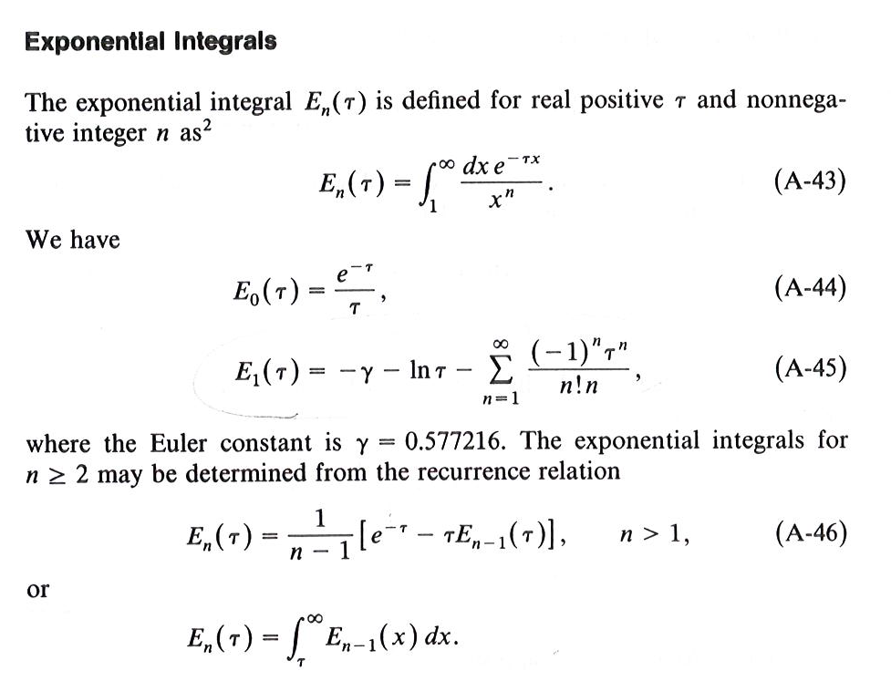

Slide 15

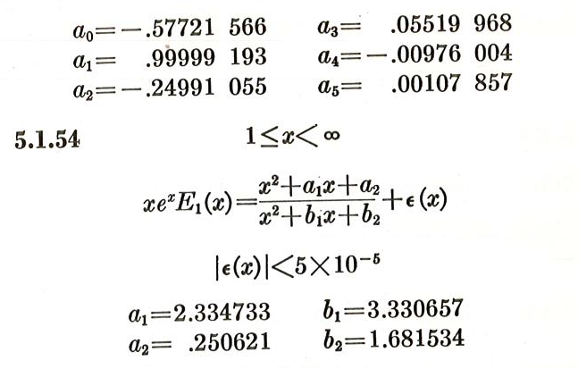
From Abramowitz and Stegun:

Slide 16
Collision probability formulation
Like every other method so far, we have to convert the continuous-variable form to a discrete form.
Using a spatial mesh as before:
where:
x₁
x₂
x₃
x₄
x₅
x₆
x₇
x₈
x₉
x₁₀
x
x
x
x
x
x
x
x
x
x
xright
xleft
x_{i-1/2}
x_{i}
x_{i+1/2}
Cell i

Slide 17
CP formulation (2)
If, as before, we define the average flux in the mesh cell as:
Integral transport solutions traditionally solve for the COLLISION RATE in each mesh cell, defined as:

Slide 18
CP formulation (3)
If we assume a spatially flat source within each cell
Multiplying both sides of the equation on the previous slide by and putting in the flat source gives us:
where I is the number of mesh cells and:

Slide 19
CP formulation (4)
Notice that the Q source term includes external sources, fission sources, scattering from other groups, and within-group scattering
We can (at least) include the within-group scattering by separating it out from the others:
And writing the equation as:

Slide 20
CP formulation (5)
Given the recurrence relationships in Appendix A for the exponential integrals, it can be shown that the transfer coefficients are given by:
and
for same-cell and different-cell transfers, respectively, where

Slide 21
External leakage formula
Starting with the equation for the internal flux, we can extend it to give us the external current on an external 1D slab boundary.
Since flux at a point is given by:
we can convert it to leakage at x=0 (assumed to be the left edge) by just multiplying by the direction cosine:

Slide 22
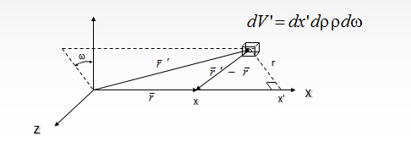
External leakage formula (1)
Again using the graph from slide 11:
It is clear that:
Giving us:

Slide 23
External leakage formula (2)
Once again dividing the x-domain into discrete pieces with constant source in each, we get:
With a change of variable

Slide 24
External leakage formula (3)
This becomes our final form:
This formula gives the right leakage coefficients if the taus are interpreted as mfp from right boundary to cell edges

Slide 25
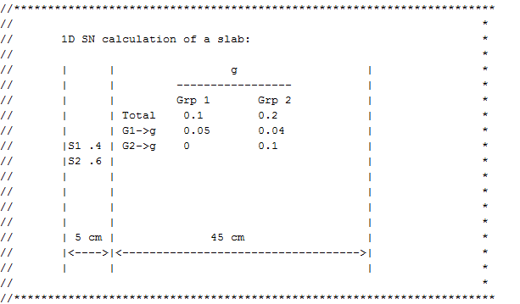
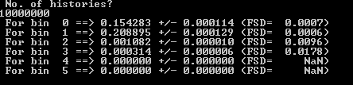
In class exercise: Write 1D slab 2 group

