Slide 1
Lesson 13 Objectives
Mathematical basics of what sets the convergence rate
Typical ways to acceleration the convergence rate
  Coarse mesh rebalance
  Synthetic acceleration
  Extrapolation methods

Slide 2
Energy solution strategies: Fixed source
The resulting energy group equations are coupled through scattering and fission
We will first deal with non-fission situation, where the group equation is:

Slide 3
Matrix formulation
Write this in “matrix operator” form by defining operators:
Combine them into a single matrix operator:

Slide 4
Matrix formulation (2)
The resulting matrix relationship is:
Note: For infinite medium=true matrix

Slide 5
Mathematical basics of acceleration
The inner iteration can be written as:
or, formally,
where represents the numerical methods we use to find the flux from a fixed source.
If we use the “infinite” iterate to represent the converged solution:

Slide 6
Mathematical basics (2)
we can define the ERROR flux as:
From this, we can see that is an operator that turns one iteration’s error into the next iteration’s error.
The question is whether this is an operator that decreases the size of what it operates on (and whether we can devise a faster-decreasing version of it).

Slide 7
Mathematical basics (3)
For convenience, we will give it the name “A”:
and simplify the notation to:
The properties of A determine the convergence rate of our inner iteration.
Also, it is of interest what the SIGN of A is (though it doesn’t affect whether it converges or not)

Slide 8
Mathematical basics (4)
Our examination of A centers on the determination of its eigenvalues and eigenfunctions:
These eigenfunctions are those strange, special functions that produce smaller copies of themselves when operated on by A. (We don’t actually have to find them, just consider them abstractly!)
is the eigenfunction and represents how big the “copy” is: Our overall goals are is to make sure each is between -1 and 1 (a negative eigenvalue turns the copy negative as well as changing its size) and to make the largest be as small as possible.
For our convenience in our task, we number the eigenvalue/eigenfunction pairs from largest to smallest in value:

Slide 9
Mathematical basics (5)
Now, we are going to assume (and leave the details to the mathematicians) that the set of eigenfunctions is COMPLETE.
This means that we assume that ANY function of space and direction can be “built” by combining eigenfunctions:
where the tells us how much of eigenfunction is in the error function
  We never actually DETERMINE these coefficients! We just consider them abstractly
In particular, the ERROR function at any iteration k can be expanded like this:

Slide 10
Mathematical basics (6)
Here is the punch line: Because these building blocks are EIGENFUNCTIONS, we can determine the coefficients for iteration k+1 from the coefficients of iteration k:
So, after each iteration, each coefficient is smaller by a factor of its eigenvalue. AFTER MANY iterations, the error will come to be shaped like the eigenfunction corresponding to the largest eigenvalue:, , and thereafter decrease smoothly by a factor of each iteration.

Slide 11
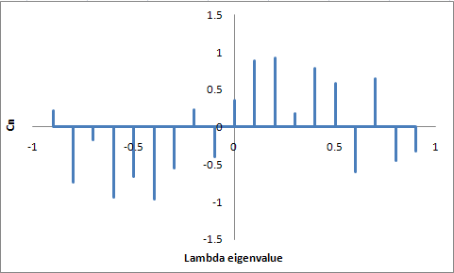
Mathematical basics (7)
It helps to think of this graphically. At any time, the error can be abstractly represented by the “proportion” of each eigenfunction it is composed of.
We can graph this using the eigenVALUES as the x axis and the amount of the coefficient in the y axis:

Slide 12
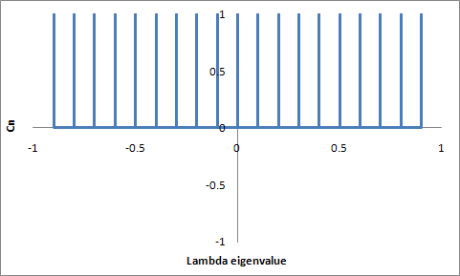
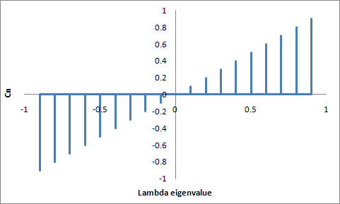
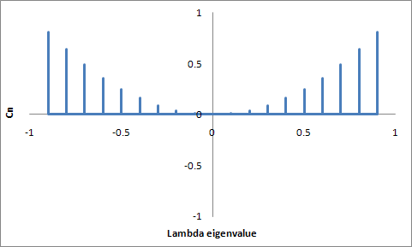
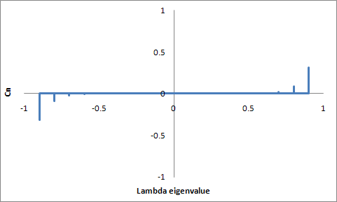
Mathematical basics (8)
To show the progression iteration-by-iteration, we start with an error that has 1 for its coefficient for all eigenvalues and move it through:
After 0 iterations After 1 iteration
After 2 iterations After 11 iterations

Slide 13
Mathematical basics (9)
A few strategic points to make:
The distance between the HIGHEST eigenvalue and 1 OR the distance between the LOWEST eigenvalue and -1 (whichever one is closest) is the DETERMINING FACTOR in how fast the error will disappear with iteration. (These stick around in the error.)
  These higher eigenvalues are associated with SMOOTH, slowly-varying, “low frequency” shapes of the error (i.e., the eigenfunction)
The closer an eigenvalue is to 0, the quicker it will disappear.
  These tend to be very erratic, quickly-varying, “high frequency” shapes of the eigenfunction.
The strategies for using these “eigenvalue shifting” techniques fall into two categories:
  Estimate the largest eigenvalue (usually by running the method “unaccelerated” and watch how fast the answer changes) and then try to shift this eigenvalue from 1. [“Extrapolation” methods]
  Add a faster, approximate technique (e.g., diffusion theory) to “guess” the answer. [“Correction” methods.]

Slide 14
Mathematical basics (10)
All of the inner iteration acceleration methods (formally) replace the standard equation:
with a MID-COURSE CORRECTION.
Let k+1/2 denote what the next iteration WOULD HAVE produced:
We take this answer as a “guess” and apply some sort of ACCELERATION operator to it.

Slide 15
Category 1: Extrapolation methods
The first family of acceleration methods is completely mathematical, requiring no knowledge about the operator. (They are extremely easy to code!)
These methods simply observe the converging behavior and try to hurry the process along using the simple formula:
Notice the ω represents the fraction of the flux change that is actually applied:
ω>1 Over-relaxation
ω<1 Under-relaxation

Slide 16
Extrapolation methods (2)
The mathematical basis of relaxation methods is that the iteration is changed from:
to:

Slide 17
Extrapolation methods (3)
Using the same analysis as before, we get:
The bracketed term is the NEW eigenvalue which is ω times farther from 1 than the original eigenvalue:

Slide 18
Extrapolation methods (4)
Over-relaxation is appropriate for situations where the largest (absolute) value eigenvalue is close to POSITIVE one. For such a system, the answer converges from one side (like landing an airplane)
  In practice, the JACOBI scheme tends to have positive-only error eigenvalues (which is why we keep it around). It responds very well to extrapolation methods, better than Gauss-Seidel which tends to have NEGATIVE eigenvalues as well.
Under-relaxation is appropriate for situations where the dominant eigenvalue is close to (or beyond) -1. For these systems (rare in NE) the answer oscillates on either side of the correct answer (like a swinging saloon door).

Slide 19
Application of extrapolation methods
The three most commonly used extrapolation methods are:
Straight extrapolation, which is the occasional use of:
In practice, one estimates from successive flux change norms:

Slide 20
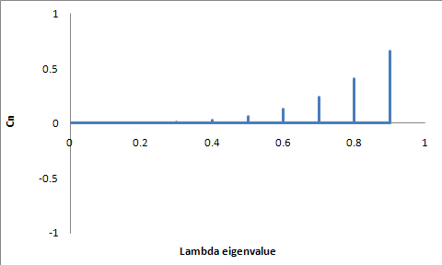
Application of extrap. (2)
To see this graphically, assume that a POSITIVE only eigenvalue system with unit coefficients:
has run for 4 interations, giving us this:

Slide 21
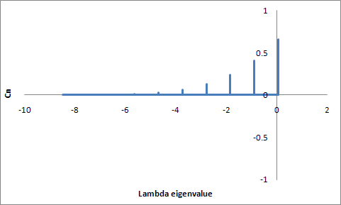
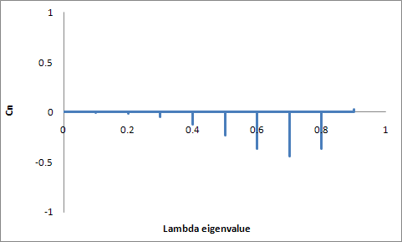
Application of extrap. (3)
Then we apply an extrapolation that shifts the largest one to 0.05 (since it is hard to estimate it exactly right!):
When we run one extrapolated iteration and then shift back to the non-extrapolated system, our eigenvalues look like this:

Slide 22
Application of extrap. (4)
When enough iterations have been run so that has settled down, a single extrapolation is done.
Then we start over trying to estimate from the unaccelerated flux changes.
  We don’t do this to DETERMINE (since we already know it), but to allow the high-frequency eigenfunctions (which we accentuated in our extrapolation) to die away again.

Slide 23
Application of extrap. (5)
Successive over-relaxation (SOR) is a continuous application of :
(once a good estimate of has been found from flux changes). This relation is based on using the largest ω that is guaranteed to converge faster than lower ω’s.

Slide 24
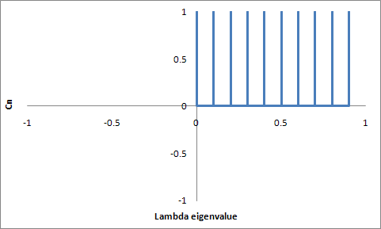
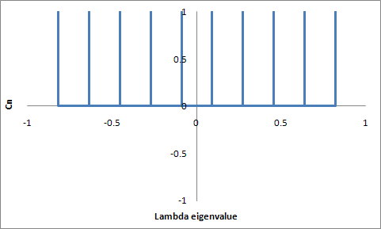
Application of extrap. (6)
Graphically, we relax the original (positive only with max of λ₀):
into

Slide 25
Application of extrap. (7)
Chebyshev acceleration is based on continuously CYCLING through a series of carefully chosen ω values once a good estimate of has been found from flux changes).
  Obviously, the result of a CYCLE of extrapolations is the PRODUCT of the effect of each (just like N unaccelerated iterations is λ^{N})
  We will not discuss the theory of this, but you should know that it is based on extrapolating to zero out the roots of Chebyshev polynomials (an orthogonal function set similar to Legendre polynomials) shifted to the eigenvalue range.
  The homework problem plays with this concept

Slide 26
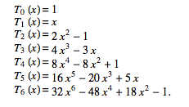
Application of extrap. (7)
The first few Chebyshev polynomials are:

Slide 27
Category 2: Correction methods
The second category of acceleration methods INSERT a simpler (i.e., faster) transport method BETWEEN iterations
These have to be VERY CAREFULLY constructed to make sure that they are forcing the solution to the SAME flux as the original transport method.
  This is called a “CONSISTENT” method and can be very tricky to construct.

Slide 28
Coarse Mesh Rebalance methods
Rebalance methods predict where the flux is going by forcing PARTICLE BALANCE over some COARSE version of the calculational grid (i.e., fewer energy groups, spatial subdivisions, or directions)
Based on the fact that iterative methods only achieve balance at the END, when convergence is met:
For each COARSE mesh calculational element, we have a multiplicative correction factor,

Slide 29
CM Rebalance methods (2)
where
If we plug this into both sides of the standard equation and integrate (sum?) both sides over the coarse mesh region, m, we get:

Slide 30
CM Rebalance methods (3)
In this form it is a little abstract, but in PRACTICE the process becomes one of finding the balance terms of each of the COARSE MESH regions for the current best (but non-balancing) solution:
  Total absorption in the CM region
  Total leakage from each CM region each neighboring CM region
  Total scattering from each CM region to each other CM region (i.e., for CM regions covering the same space, but different energy groups)
Find the “CM correction factors” that restore the balance.
Correct all fluxes using the correction factors.

Slide 31
CM Rebalance methods (4)
Because we have been so abstract, we can apply it several different ways:
Combine all angles into a single CM, but same energy and space subdivision. (“cell rebalance”). (Traditional CM acceleration for inner iterations.)
Combine all angles and create large spatial CM regions, use all energy groups. (Traditional CM acceleration for outer iterations.)

Slide 32
Synthetic acceleration methods
This method has a feel like CM rebalance, but the correction factors are ADDITIVE and are found by a simplified calc. method.
Most common is Diffusion Synthetic Acceleration (DSA), which uses diffusion theory as the simplified method.
The math basis is to subtract what we HAVE:
from what we WANT to have:

Slide 33
Diffusion Synthetic Acceleration
to get:
If we add and subtract on the RHS and rearrange, we get:
or

Slide 34
DSA (2)
The additive correction to the flux can be found by solving the SAME problem, replacing the source with the SCATTERING operator operated on the latest flux change.
Of course, as we near convergence, this source term will shrink to nothing.
Operationally, though, this equation is no easier to solve than the original. We save time by using an APPROXIMATE operator (diffusion theory) in place of H:

Slide 35
Homework 11-1
Show that the optimum continuously applied overrelaxation factor (SOR) is given by:
IF you know that error eigenvalues lie between 0 and λ₀
What if you knew the error eigenvalues fall between 0.5 and 0.95, what would the optimum SOR overrelaxation factor be? (ANS=3.636363…)

Slide 36
Homework 11-2
If you know that the error eigenvalues of your system are uniformly distributed between 0 and 0.95, what would be the expected convergence rate if you used the best optimum SOR value? (1.9047➔0.90476)
What if you alternated between ω=4 and ω=1.25? (0.866025)
What would be the best two ω values to alternate between? (5.287528,1.161608➔0.832405)
Best four? (1.03751,1.414878,11.60669,2.913538➔0.74969)

